Slide 1
SAR : Decoding for PEVs
Dr. R. V. Ranganath
Professor,
Department of Civil Engineering,
BMS College of Engineering, Bangalore -19
rvranganath.civ@bmsce.ac.in
11.08.2023 (VJTI Mumbai)

Slide 2
SAR Context
Provides preparedness status at I/P level for the NBA visit,
Provides the first impression about the I/P to the evaluation team,
Presents crisp program status to the evaluation team and addresses process and the extent to which, a program meets each criterion,
Provides documented evidences, which the evaluation team maps/matches with the visual /oral evidences during the visit.

Slide 3
SAR Contents
PART A | Institutional Information
PART B | Criteria Summary
Criteria No. | Program Level Criteria
1 | Vision, Mission and Program Educational Objectives
2 | Program Curriculum and Teaching-Learning Processes
3 | Course Outcomes and Program Outcomes
4 | Students’ Performance
5 | Faculty Information and Contributions
6 | Facilities and Technical Support
7 | Continuous Improvement

Slide 4
Contd.
Criteria No. | Institute Level Criteria
8 | First Year Academics
9 | Student Support Systems
10 | Governance, Institutional Support and Financial Resources
PART C | Declaration by the Institution
Annexure-I | Program Outcomes (POs) & Program Specific Outcomes (PSOs)

Slide 5
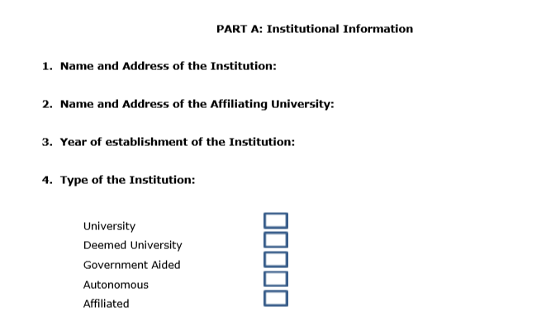
PART A:Institutional Information

Slide 6
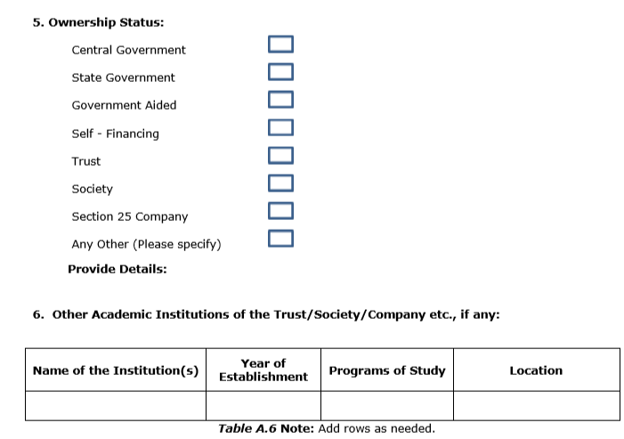
PART A:Institutional Information

Slide 7
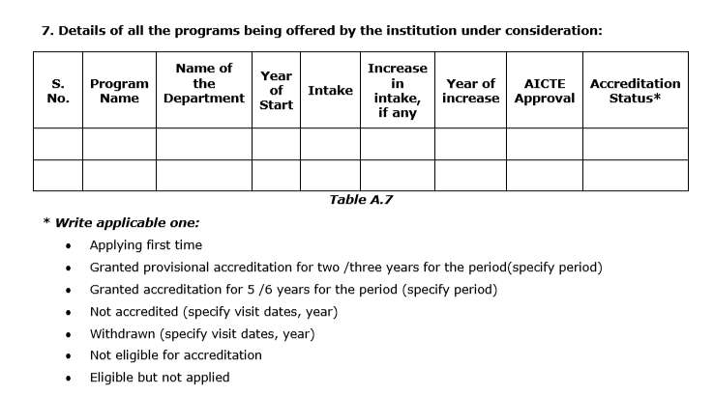
PART A:Institutional Information

Slide 8
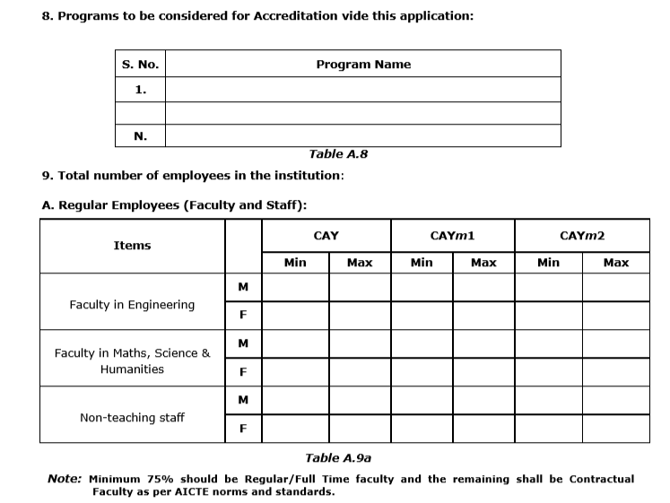
PART A:Institutional Information

Slide 9
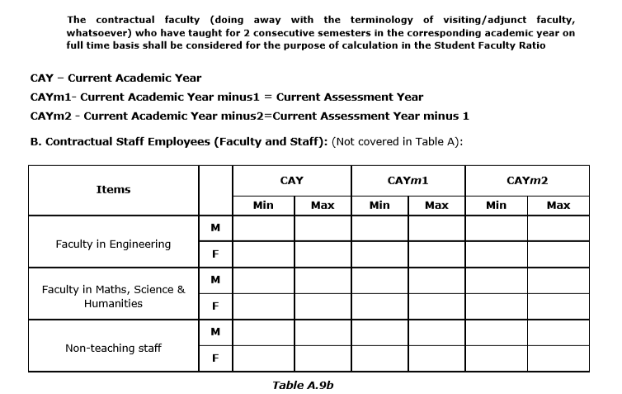
PART A:Institutional Information

Slide 10
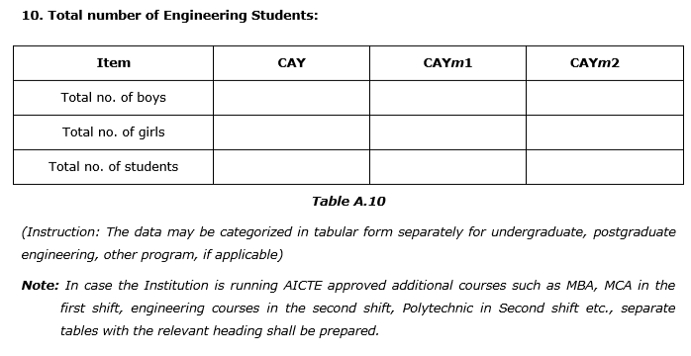
PART A:Institutional Information

Slide 11
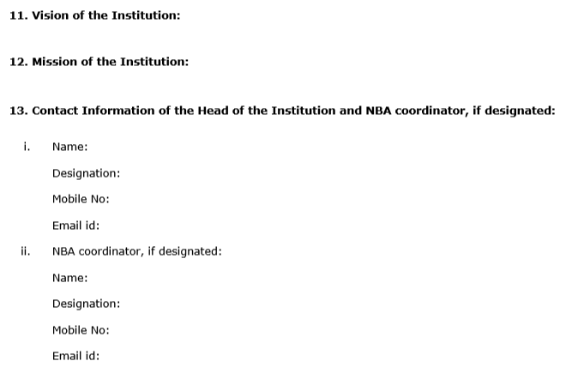
PART A:Institutional Information

Slide 12
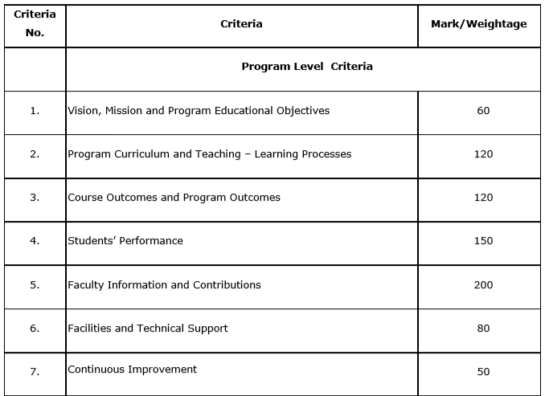
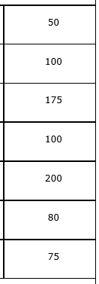
PART B: Criteria Summary
Tier 2
Tier 1
780

Slide 13
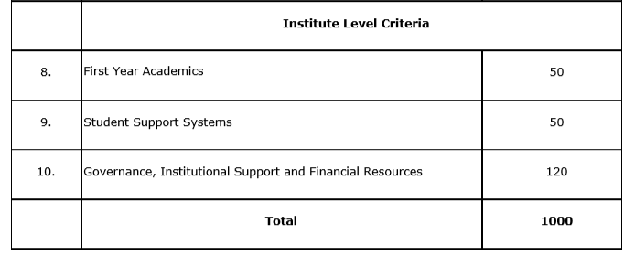
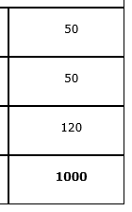
PART B: Criteria Summary
Tier 2
Tier 1
220

Slide 14
CRITERION-1: Vision, Mission and Program Educational Objectives (PEOs)
1.1. State the Vision and Mission of the Department and Institute.(5)
Vision statement typically indicates aspirations and Mission statement states the broad approach to achieve aspirations
Should be written in a simple language, easy to communicate and should define objectives which are out of reach in the present context
Department Vision and Mission statements shall be consistent with the Institute Vision and Mission statements
1

Slide 15
Vision and Mission Statements
(as per NBA document)
Vision is a futuristic statement that the institution would like to achieve over a long period of time, and Mission is the means by which it proposes to move toward the stated Vision
Example..
Vision:
To emerge as one of the nation’s finest Institutions in the field of Technical Education and Research through focused, effective and sustained monitoring of its programmes and resources.
Mission:
To develop high quality professionals ingrained in ethics, wisdom and creativity for the betterment of the society.
Action verb ?? Verb

Slide 16
Corrected Vision and Mission Statements
Vision:.
To emerge as one of the nation’s finest Institutions of higher learning in the field of Technical Education to develop professionals who are technically competent, ethical, environment friendly for betterment of society.
Mission:
Accomplish stimulating learning environment for students through quality teaching, research and outreach activity by providing state of the art facilities, industry exposure and guidance of dedicated faculty

Slide 17
Department Vision and Mission Statements (Sample)
Vision:
To be an excellent centre for imparting quality higher education in Civil Engineering for a constantly changing societal needs with credibility, integrity and ethical standards.
Mission:
Accomplish excellence in curricular, co-curricular activities with a committed faculty through quality teaching and research which creates technically competent and dedicated civil engineers to serve their surroundings with pride.
PIs: 1. Excellence in Curricular and Co-curricular activities
2. Quality teaching and research,,,,
3. Technically competent engineers,,,

Slide 18
Evaluation
A. Availability of the Vision and Mission statements of the Department (1)
B. Appropriateness/Relevance of the Statements (2)
C. Consistency of the Department statements with the Institute statements (2)
(Here Institute Vision and Mission statements have been asked to ensure consistency with the department Vision and Mission statements; the assessment of the Institute Vision and Mission will be done in Criterion 10)
Exhibits/Context to be Observed/Assessed:
Vision & Mission Statements
Correctness from definition perspective
Consistency between Institute and Department statements

Slide 19
Contd.
1.2. State the Program Educational Objectives (PEOs) (5)
Define the PEOs under the following broad categories:
  Preparation : Employment/Higher studies
  Core competence : Discipline knowledge
  Professionalism : Professional value - knowledge development
  Life long learning : Environment
A. Listing of the Program Educational Objectives (3 to 5) of the program under consideration (5)
Exhibits/Context to be Observed/Assessed:
Availability & correctness of the PEOs statements

Slide 20
PEOs (Samples)
Graduates after 3-5 years, will be able to:
PEO1:
Compete on a global platform to pursue their professional career in Electrical Engineering and allied disciplines.
PEO2:
Pursue higher education and/or engage in continuous up gradation of their professional skills.
PEO3:
Communicate effectively while working in diverse team.
PEO4:
Demonstrate concern for society and environment.

Slide 21
Contd.
1.3. Indicate where the Vision, Mission and PEOs are published and disseminated among stakeholders (PEOs) (10)
    Availability on Institute website under relevant program link
    Availability at department notice boards
    Department website, if available
    Availability in department level documents
    Documentary evidence
A. Adequacy in respect of publication & dissemination (2)
B. Process of dissemination among stakeholders (2)
C. Extent of awareness of Vision, Mission and PEOs among the stakeholder (6)

Slide 22
Contd.
Exhibits/Context to be Observed/Assessed:
A. Adequacy
Department Vision, Mission and PEOs: Availability on Institute website under relevant program link; Availability at department notice boards, HoD Chamber, department website, if Available; Availability in department level documents/course of study
B. Process of dissemination
Documentary evidence to indicate the process which ensures awareness among internal and external stakeholders with effective process implementation
C. Extent of Awareness
Based on interaction with internal and external stakeholders

Slide 23
Contd.
1.4. State the process for defining the Vision and Mission of the Department and PEOs of the program (25)
Process to ensure:
    Effective participation of Stakeholders
    Effective Process implementation
    Documentary evidence
A. Description of process involved in defining the Vision, Mission of the Department (10)
B. Description of process involved in defining the PEOs of the program (15)
Exhibits/Context to be Observed/Assessed:
Documentary evidence to indicate the process which ensures effective participation of internal and external department stakeholders with effective process implementation

Slide 24
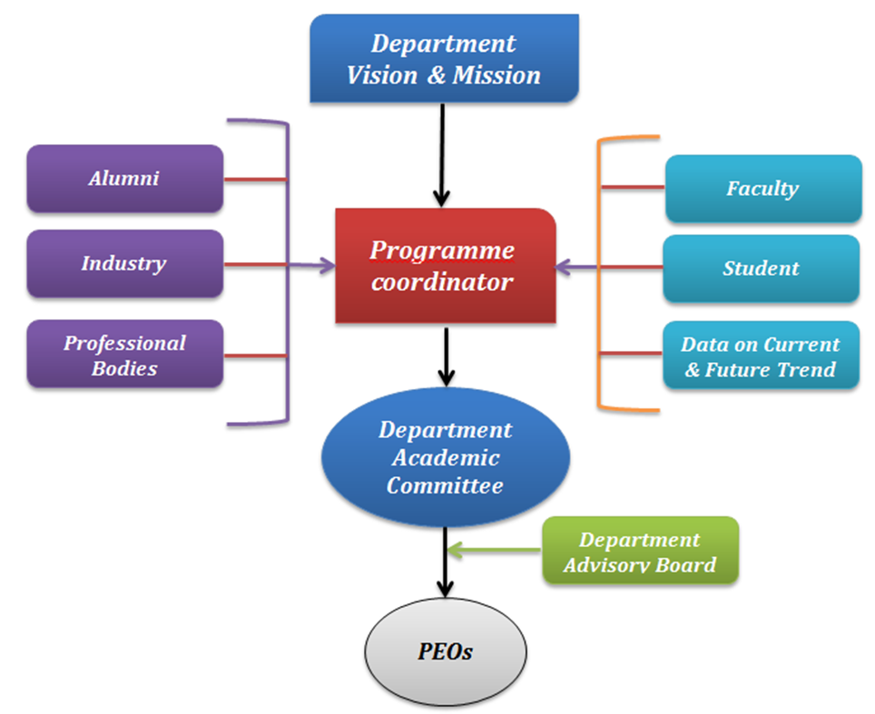
Processes for PEOs
Feedback format for collecting data from stakeholders
A process by which PEOs are created and reviewed periodically
A process to evaluate to what extent PEOs are attained.

Slide 25
Contd.
1.5. Establish consistency of PEOs with Mission of the Department (15)
Generate a “Mission of the Department – PEOs matrix” with justification and rationale of the mapping:
PEO Statements | M1 | M2 | …… | Mn
PEO 1
PEO 2
PEO 3
PEO 4
Note: M1, M2, . . Mn are distinct elements of Mission statement.
Enter correlation levels 1, 2 or 3 as defined below:
1: Slight (Low)
2: Moderate (Medium)
3: Substantial (High)
If there is no correlation, put “-”

Slide 26
Mission of the Department:
M1: Make competent Civil Engineers with high level of professional, moral and ethical values
M2:Impart highest standards in theoretical as well as practical knowledge and skill set
M3:Establish Center of Excellence in major areas of Civil Engineering to respond to the current and future needs of the industry
PEO1: Graduates will have successful career in the field of Civil Engineering
PEO2: Graduates will respond to growing demands of society through professional and ethical practices
PEO3: Graduates will pursue lifelong learning including higher studies in the field of Civil Engineering
What is Expected here ?
Establish consistency of PEOs with Mission of the Department (15)
Generate a “Mission of the Department – PEOs matrix” with justification and rationale of the mapping
PEO Statements | M1 | M2 | …… | Mn
PEO 1 | 3/2/1 ? | 3/2/1 ?
PEO 2
PEO 3 | 3/2/1 ?

Slide 27
A. Preparation of a matrix of PEOs and elements of Mission statement (5)
B. Consistency/justification of co-relation parameters of the above matrix (10)
Exhibits/Context to be Observed/Assessed:
Availability of a matrix having PEOs and Mission elements
Justification for each of the elements mapped in the matrix

Slide 28
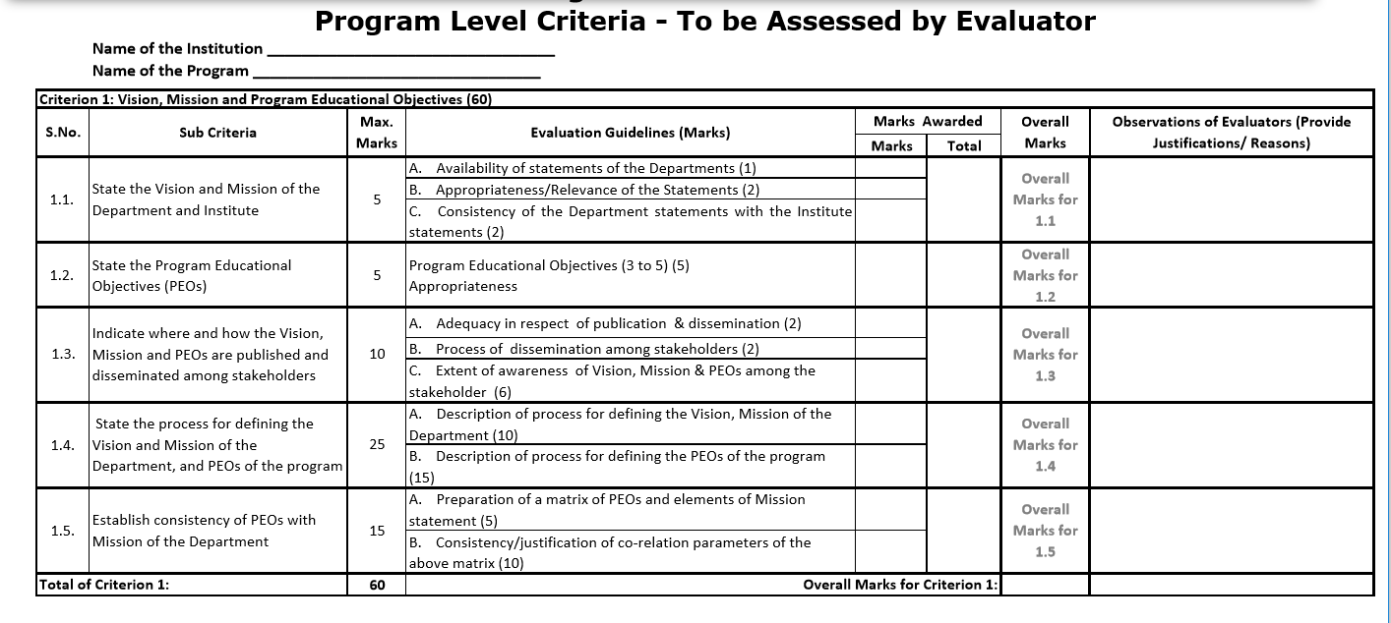

Slide 29
CRITERION-2: Program Curriculum and Teaching – Learning Processes (TLP)
2.1. Program Curriculum (20)
2.1.1. State the process used to identify extent of compliance of the University curriculum for attaining the Program Outcomes and Program Specific Outcomes as mentioned in Annexure-I. Also mention the identified curricular gaps, if any (10)
  State the process details
  Mention identified curricular gaps
  Extent of compliance
Exhibits/Context to be Observed/Assessed:
Documentary evidence to indicate the process which ensures mapping/compliance of University Curriculum with the POs & PSOs; Identification of gaps; if any.
Identified Curricular gaps and its Appropriateness

Slide 30
Contd.
2.1.2. State the delivery details of the content beyond the syllabus for the attainment of POs & PSOs (10)
Details of the following for the attainment of POs & PSOs
    Additional course
    Learning material/Content
    Laboratory experiments
    Projects etc.
Institute to provide inputs to the Affiliating University regarding curricular gaps and possible addition of new content/add-on courses in the curriculum to better attain program outcome(s)

Slide 31
Curriculum- Tier 2
• Analyze the University Curriculum
• Determine the Gaps in Attainment of POs
• Design Extra {modules} I {Assessments}
to Bridge these gaps
• Could need a few iterations
(Ex; Say, Financial Management course or any activities related to PO11 are missing totally or insufficient through what is provided in Univ curriculum, Then, what do you do ?)

Slide 32
Analysis may indicate that not all POs are Attainable with the Given Curriculum.
May need some additional modules and Design of In-Sem evaluation and assessment to take care of the gaps.
A record of all this work is needed.

Slide 33
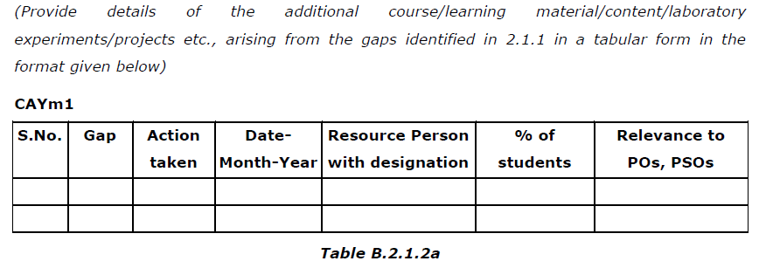
Steps taken to get identified gaps included in the curriculum. (e.g. letter to university/BOS) (2)
Delivery details of content beyond syllabus (5)
Mapping of content beyond syllabus with the POs & PSOs (3)
Exhibits/Context to be Observed/Assessed:
Documentary evidence of steps taken at regular interval
Delivered details – documentary evidence for at least one sample per assessment year to be verified
Availability and appropriateness of Mapping table between contents delivered and Program outcomes/Program specific outcomes (Course outcomes)

Slide 34
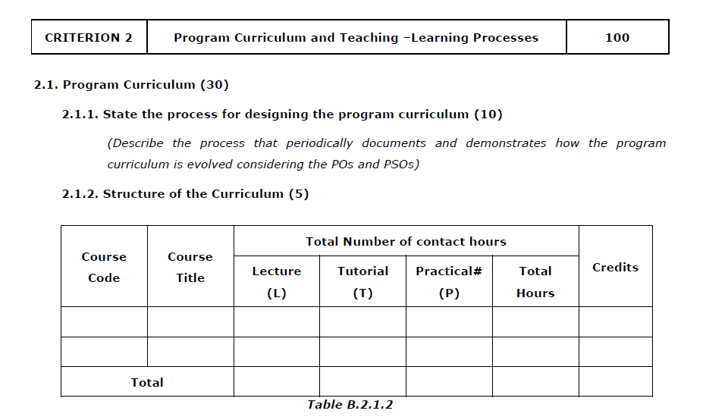
Tier 1:

Slide 35
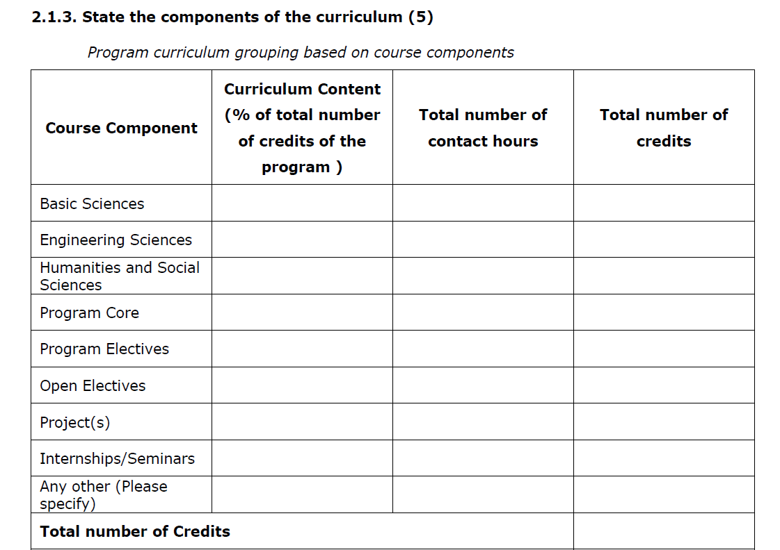
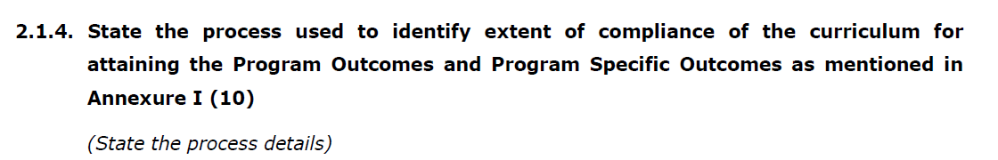

Slide 36
Contd.
2.2. Teaching-Learning Processes.
2.2.1. Describe Processes followed to improve quality of Teaching and Learning (25)
Processes may include adherence to academic calendar and implementation of pedagogical initiatives such as -
      Real life examples
      Collaborative learning
      Quality of laboratory experience with regard to conducting experiments
      Recording observations
      Analysis of data etc.
      Encouraging bright students
      Assisting weak students etc.
      ICT supported learning
      Interactive classrooms

Slide 37
Adherence to Academic Calendar (3)
Use of various instructional methods and pedagogical initiatives (3)
Methodologies to support weak students and encourage bright students(4)
Quality of classroom teaching (Observation in a Class) (3)
Conduct of experiments (Observation in Lab) (3)
Continuous Assessment in the laboratory (3)
Student feedback of teaching learning process and actions taken (6)
Exhibits/Context to be Observed/Assessed:
Availability of Academic Calendar based on University academic calendar and its effective compliance
Documentary evidence to support implementation of pedagogical initiatives such as real life examples, collaborative learning, ICT supported learning, interactive class rooms etc.
Guidelines to identify weak and bright students; post identification actions taken; impact observed
Class room ambience; efforts to keep students engaged (also to be verified during interaction with the students)
Quality of laboratory experience with respect to conducting, recording observations, analysis etc.(also to be verified during interaction with the students)
Internal Semester examination and internal marks thereof, Practical record books, each experiment assessment, final marks based on assessment of all the experiments and other assessments; if any
Feedback format, frequency, analysis and actions taken (also to be verified during interaction with students)

Slide 38
Contd.
2.2.2. Quality of internal semester Question papers, Assignments and Evaluation.(20)
Mention the initiatives, Implementation details and analysis of learning levels related to –
              Quality of Semester Question papers
              Assignments
              Evaluation
              Relevance to COs
Exhibits/Context to be Observed/Assessed:
Process of internal semester question paper setting, model answers, evaluation and its compliance
Question paper validation to ensure desired standard from outcome attainment perspective as well as learning levels perspective
Mapping of questions with the Course outcomes Course files
Assignments to promote self-learning, survey of contents from multiple sources, assignment evaluation and feedback to the students, mapping with the Cos

Slide 39
Contd.
2.2.3. Quality of Student Projects (25)
  Consideration to factors including, but not limited to –
    Environment & Safety
    Ethics
    Cost
    Type (application, product, research, review etc.)
    Standards
    Processes related to project identification, allotment, continuous monitoring and evaluation
    Demonstration of working prototype sand enhancing the relevance of projects.
    Mention Implementation details including details of POs and PSOs addressed with justification
Look for evidence of solving Complex Engineering Problems/Activities.
Exhibits/Context to be Observed/Assessed:
A. Projects identification and guide allocation Process
B. Projects classification (application, product, research, review etc.) consideration to factors such as environment, safety, ethics, cost, standards and mapping with program outcomes and program specific outcomes
C. Continuous monitoring mechanism and evaluation
D. Methodology (Appropriately documented) to assess individual contribution/ understanding of the project as well as collective contribution/understanding
E. Based on Projects demonstration
F. Quality of place (host) where the paper has been published /quality of competition in which award has been won

Slide 40
Contd.
2.2.4. Initiatives related to industry interaction (15)
  Industry supported laboratories.
  Industry involvement in the program design and partial delivery of any regular courses for students.
  Impact analysis of industry institute interaction and actions taken thereof
Exhibits/Context to be Observed/Assessed:
A. Type of Industries, Type of Labs, objectives, utilization and effectiveness
B. Documentary evidence
C. Analysis and actions taken thereof
2.2.5. Initiatives related to industry internship/summer training (15)
  Industrial training/tours for students.
  Industrial / internship / summer training of more than two weeks and post training Assessment.
  Impact analysis of industrial training.
  Student feedback on initiatives

Slide 41
Exhibits/Context to be Observed/Assessed:
A. & B. Type of Industries, planned or non-planned activity, objectives clearly defined, no. of students participated, relevant area of training, visit report documented
C.& D. Impact analysis and feedback format, analysis and actions taken (also to be verified during interaction with students)

Slide 42
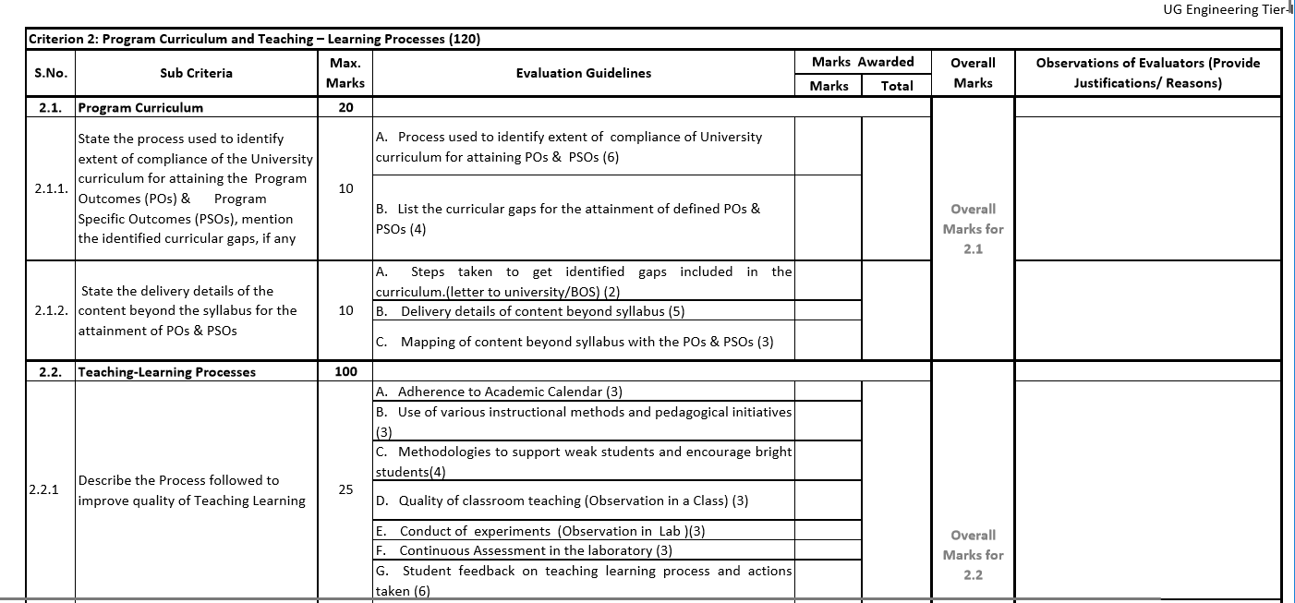

Slide 43
CRITERION 3: Course Outcomes and Program Outcomes
3.1. Establish the correlation between the Courses and the Program Outcomes (POs) and Program Specific Outcomes (PSOs)
3.1.1. Course Outcomes (COs)
SAR should include course outcomes of One course/Semester (3rd to 8th) of study, however, should be prepared for all courses and made available as evidence
Exhibits/Context to be Observed/Assessed:
A. Appropriateness of the statements shall be seen for atleast one course each from 2nd, 3rd and final year of study
Notes:
-

Slide 44
Program Outcomes
POs are statements about the knowledge, skills and attitudes (attributes) the graduate of a formal engineering program should have.
Profile of the Graduates reached through POs - Target
POs are defined by Accreditation Agencies of the country (NBA in India)
Defining these is the Starting Point

Slide 45
Program Outcomes (POs)
Engineering Knowledge: Apply the knowledge of mathematics, science, engineering fundamentals, and an engineering specialization to the solution of complex engineering problems.
Problem Analysis: Identify, formulate, review research literature, and analyze complex engineering problems reaching substantiated conclusions using first principles of mathematics, natural sciences, and engineering sciences.
Design/Development of Solutions: Design solutions for complex engineering problems and design system components or processes that meet the specified needs with appropriate consideration for the public health and safety, and the cultural, societal, and environmental considerations
Conduct Investigations of Complex Problems: Use research-based knowledge and research methods including design of experiments, analysis and interpretation of data, and synthesis of the information to provide valid conclusions.

Slide 46
Conti…
Modern Tool Usage: Create, select, and apply appropriate techniques, resources, and modern engineering and IT tools including prediction and modeling to complex engineering activities with an understanding of the limitations.
The Engineer and Society: Apply reasoning informed by the contextual knowledge to assess societal, health, safety, legal and cultural issues and the consequent responsibilities relevant to the professional engineering practice.
Environment and Sustainability: Understand the impact of the professional engineering solutions in societal and environmental contexts, and demonstrate the knowledge of, and need for sustainable development.
Ethics: Apply ethical principles and commit to professional ethics and responsibilities and norms of the engineering practice.

Slide 47
Conti…
Individual and Team Work: Function effectively as an individual, and as a member or leader in diverse teams, and in multidisciplinary settings.
Communication: Communicate effectively on complex engineering activities with the engineering community and with society at large, such as, being able to comprehend and write effective reports and design documentation, make effective presentations, and give and receive clear instructions.
Project Management and Finance: Demonstrate knowledge and understanding of the engineering and management principles and apply these to one’s own work, as a member and leader in a team, to manage projects and in multidisciplinary environments.
Life-long Learning: Recognize the need for, and have the preparation and ability to engage in independent and lifelong learning in the broadest context of technological change.

Slide 48
Washington Accord Graduate Attributes
(Revised Version 4.0 Vis-a-Vis Existing Version 3.0)
Differentiating Characteristic | GAPC 4.0 … for Washington Accord Graduate | GAPC 3.0 … for Washington Accord Graduate
Engineering Knowledge: Breadth, depth and type of knowledge, both theoretical and practical | WA1: Apply knowledge of mathematics, natural science, computing and engineering fundamentals and an engineering specialization as specified in WK1 to WK4 respectively to develop the solution of complex engineering problems. | WA1: Apply knowledge of mathematics, natural science, engineering fundamentals and an engineering specialization as specified in WK1 to WK4 respectively to the solution of complex engineering problems.
Problem Analysis: Complexity of analysis | WA2: Identify, formulate, research literature and analyse complex engineering problems reaching substantiated conclusions using first principles of mathematics, natural sciences and engineering sciences with holistic considerations for sustainable development. (WK1 to WK4) | WA2: Identify, formulate, research literature and analyse complex engineering problems reaching substantiated conclusions using first principles of mathematics, natural sciences and engineering sciences. (WK1 to WK4)
Design/ development of solutions: Breadth and uniqueness of engineering problems i.e. the extent to which problems are original and to where solutions have not previously been identified or codified | WA3: Design creative solutions for complex engineering problems and design systems, components or processes to meet identified specified needs with appropriate consideration for public health and safety, whole-life cost, net zero carbon, as well as resource, cultural, societal, and environmental considerations as required. (WK5) | WA3: Design solutions for complex engineering problems and design systems, components or processes that meet specified needs with appropriate consideration for public health and safety, cultural, societal, and environmental considerations. (WK5)
Investigation: Breadth and depth of investigation and experimentation | WA4: Conduct investigations of complex engineering problems using research based knowledge(WK8) methods including research-based knowledge, design of experiments, analysis and interpretation of data, and synthesis of information to provide valid conclusions (WK8) | WA4: Conduct investigations of complex problems using research-based knowledge (WK8) and research methods including design of experiments, analysis and interpretation of data, and synthesis of information to provide valid conclusions.
Modern Tool Usage: Level of understanding of the appropriateness of technologies and various tools | WA5: Create, select and apply, and recognize limitations of appropriate techniques, resources, and modern engineering and IT tools, including prediction and modelling, to complex engineering problems with an understanding of the limitations (WK2 and WK6) | WA5: Create, select and apply appropriate techniques, resources, and modern engineering and IT tools, including prediction and modelling, to complex engineering problems, with an understanding of the limitations. (WK6)
The Engineer and the World Society: Level of knowledge and responsibility for sustainable development | WA6: When solving complex engineering problems, analyze and evaluate sustainable development impacts* to: society, the economy, sustainability, health and safety, legal frameworks, and the environment (WK1, WK5, and WK7) | WA6: Apply reasoning informed by contextual knowledge to assess societal, health, safety, legal and cultural issues and the consequent responsibilities relevant to professional engineering practice and solutions to complex engineering problems. (WK7)
Continued…….

Slide 49
Differentiating Characteristic | GAPC 4.0 … for Washington Accord Graduate | GAPC 3.0 … for Washington Accord Graduate
Human, Social, Economic and Environmental impacts and Sustainability: Type of solutions. | WA7: Understand and evaluate the sustainability and impact of professional engineering work in the solution of complex engineering problems in human, cultural, economic, social etal and environmental contexts. (WK7) | WA7: Understand and evaluate the sustainability and impact of professional engineering work in the solution of complex engineering problems in societal and environmental contexts. (WK7)
Ethics: Understanding and level of practice | WA7: Apply ethical principles and commit to professional ethics and responsibilities and norms of engineering practice and adhere to relevant national and international laws. Demonstrate an understanding of the need for diversity and inclusion (WK9) | WA8: Apply ethical principles and commit to professional ethics and responsibilities and norms of engineering practice. (WK7)
Individual and Collaborative Team work: Role in and diversity of team | WA8: Function effectively as an individual, and as a member or leader in diverse teams and inclusive teams and in multi-disciplinary, face-to-face, remote and distributed settings (WK9) | WA9: Function effectively as an individual, and as a member or leader in diverse teams and in multi-disciplinary settings.
Communication: Level of communication according to type of activities performed | WA9: Communicate effectively and inclusively on complex engineering activities with the engineering community and with society at large, such as being able to comprehend and write effective reports and design documentation, make effective presentations, and give and receive clear instructions taking into account cultural, language, and learning differences. | WA10: Communicate effectively on complex engineering activities with the engineering community and with society at large, such as being able to comprehend and write effective reports and design documentation, make effective presentations, and give and receive clear instructions.
Project Management and Finance: Level of management required for differing types of activity | WA10: Apply Demonstrate knowledge and understanding of engineering management principles and economic decision-making and apply these to one’s own work, as a member and leader in a team, and to manage projects and in multidisciplinary environments. | WA11: Demonstrate knowledge and understanding of engineering management principles and economic decision-making and apply these to one’s own work, as a member and leader in a team, to manage projects and in multidisciplinary environments.
Lifelong learning: Preparation for and depth of continuing learning. Duration and manner | WA11: Recognize the need for, and have the preparation and ability for i) independent and life-long learning ii) adaptability to new and emerging technologies and iii) critical thinking in the broadest context of technological change (WK8) | WA12: Recognize the need for, and have the preparation and ability to engage in independent and life-long learning in the broadest context of technological change.

Slide 50
Revised Program Outcomes as per GAPC 4.0
Differentiating Characteristic | Program Outcomes as per GAPC 4.0
Engineering Knowledge: Breadth, depth and type of knowledge, both theoretical and practical. | PO1: Engineering knowledge: Apply knowledge of mathematics, natural science, computing, engineering fundamentals and an engineering specialization to the solution of complex engineering problems.
Problem Analysis: Complexity of analysis. | PO2: Problem analysis: Identify, formulate, research literature, and analyze complex engineering problems reaching substantiated conclusions with consideration for sustainable development.
Design/ development of solutions: Breadth and uniqueness of engineering problems i.e. the extent to which problems are original and to where solutions have not previously been identified or codified. | PO3: Design/development of solutions: Design creative solutions for complex engineering problems and design systems/ components/processes to meet identified needs with consideration for the public health and safety, whole-life cost, net zero carbon, culture, society and environment.
Investigation: Breadth and depth of investigation and experimentation | PO4: Conduct investigations of complex problems: Conduct investigations of complex problems using research-based knowledge including design of experiments, modelling, analysis & interpretation of data to provide valid conclusions.
Tool Usage: Level of understanding of the appropriateness of technologies and tools. | PO5: Engineering Tool usage: Create, select, adapt and apply appropriate technologies/techniques and modern engineering/IT tools, in solving complex engineering problems with an understanding of the associated limitations.
The Engineer and the World: Level of knowledge and responsibility for sustainable development | PO6: Impact of Engineering on Society and the environment: Impact of Engineering on Society and the environment: Analyze societal and environmental aspects of engineering activities for impact on sustainability by understanding interactions between engineering with the economic, social, health, safety, legal, and cultural aspects of society.
Ethics: Understanding and level of practice | PO7: Ethics: Apply ethical principles and commit to professional ethics, responsibilities and norms of engineering practice.
Individual and Collaborative Team work: Role in and diversity of team Communication: Level of communication according to type of activities performed | PO8: Team Work and Communication: Work effectively as an individual, and as a member or leader in diverse multi-disciplinary teams. Communicate effectively within the profession and with society at large. Such abilities include reading, writing, speaking and listening, and the ability to comprehend and write effective reports and documentations.
Project Management and Finance: Level of management required for differing types of activity | PO09: Project management and finance: Apply knowledge and understanding of engineering management principles and economic decision-making in one’s own work, as a member/leader in a team, and manage projects in multidisciplinary environments.
Lifelong learning: Duration and manner | PO10: Life-long learning: Identify and address needs in a changing world, adapt to new and emerging technologies, develop critical thinking approach in the context of broad technological change by engaging in independent and life-long learning.

Slide 51
PROGRAM SPECIFIC OUTCOMES (PSO)
These outcomes are specific to a program in addition to NBA defined POs, namely, Civil, Mechanical, Chemical, Computer science etc.,(2-4)
ELECTRICAL & ELECTRONICS ENGINEERING
At the end of the program, students will have the ability to:
PSO1
Develop models, analyze and assess the performance of different types of generation, transmission, distribution and protection mechanisms in power systems.
PSO2
Design, develop, analyze and test electrical and electronics systems; deploy control strategies for power electronics related and other applications.
PSO3
Measure, analyze, model and control the behavior of electrical quantities associated with constituents of energy or allied systems.

Slide 52
Programme Specific Outcomes
•There should not be any repetition of POs already defined by NBA.
•Specific to the particular program
•2 to 4 in number
•Must have a process for arriving at them

Slide 53
CRITERION 3: Course Outcomes and Program Outcomes
3.1.2. CO-PO matrices of courses selected in 3.1.1 (six matrices to be mentioned; one per semester from 3rd to 8th semester)
A. Explanation of table to be ascertained (5)
Exhibits/Context to be Observed/Assessed:
A. Mapping to be verified for atleast two matrices
Notes:
-

Slide 54
Contd.
Note: Enter correlation levels 1, 2 or 3 as defined below:
  1: Slight (Low)
  2: Moderate (Medium)
  3: Substantial (High)
3.1.3. Program level Course-PO matrix of all courses INCLUDING first year courses
  It may be noted that contents of Table 3.1.2 must be consistent with information available in Table 3.1.3 for all the courses.
Exhibits/Context to be Observed/Assessed:
A. Mapping to be verified for atleast one course per year of study; program outcomes and program specific outcomes getting mapped with the core courses are also to be verified
Notes:
-

Slide 55
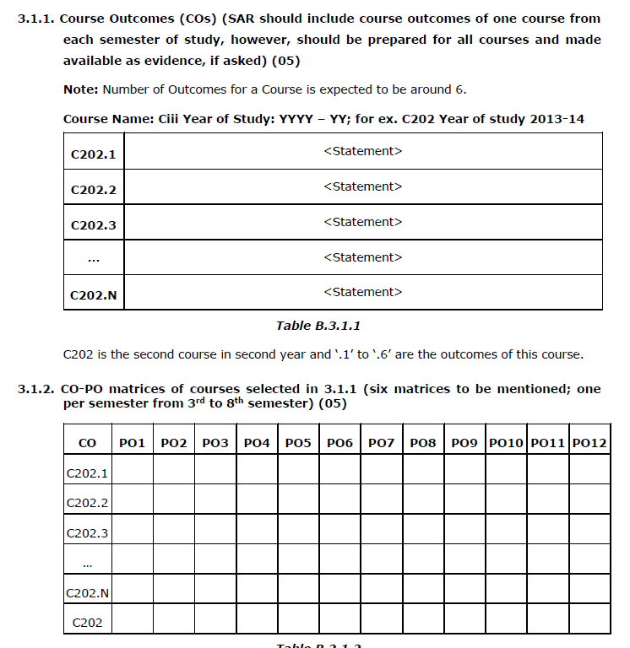

Slide 56
Course Outcomes
Engineering Physics (Not a Good Example)
CO1: Understand the knowledge of basic quantum mechanics, to set up one-dimensional Schrodinger’s wave equations and its application to few physical problems.
CO2: Understand the fundamental aspects of crystallography, able to recognize various planes in a crystal and have knowledge of structure determination using x-rays.
CO3: Understand the role of free electrons in determining the properties of metals, the concept of Fermi energy, and the domain formation in ferromagnetic materials.
CO4: Understand the basic laser physics, working of lasers, holography and principle of propagation of light in optical fibers.
CO5: Understand the theory of free, damped and forced vibrations of a particle and also the concept of resonance and its applications in ESR & NMR.
What level of BLOOM,s Taxonomy you want your students to achieve?

Slide 57
Course Title: Strength of Materials
Course Outcomes: Example
At the end of the course, student is able to:
Apply laws of physics (eg..Hook’s law, etc.,) to compute different types of response (stress and deformation) in the given materials. (PO 1)
Analyse structural elements for different force systems to compute design parameters (BM and SF) (PO2)
Design compression elements using engineering principles to resist any given loads. (PO3)
Conduct experiments to validate physical behaviour of materials/components.(PO4)
Prepare laboratory reports on interpretation of experimental results (P10)
Action Verb
Learning Statement

Slide 58
CO-PO Relationship
Each CO can be identified to address a subset of POs
Based on the number of COs and the sessions dedicated to them it is possible to identify the strength of mapping (1, 2 or 3) to POs
Based on these strengths of selected POs a CO matrix can be established.

Slide 59
PO1: Engineering Knowledge: Apply the knowledge of mathematics, science, engineering fundamentals, and an engineering specialization to the solution of complex engineering problems
Example Situation 1: CO1: Able to understand mix proportioning techniques for field applications.
Assessment for CO3: (Question in Tests) Briefly explain the various methods of mix proportioning techniques.
Does this CO reflects the intended measurement from PO1? Does the assessment correlates well with the CO? | Mapping: CO1- PO1.

Slide 60
PO3: Design/Development of Solutions: Design solutions for complex engineering problems and design system components or processes that meet the specified needs with appropriate consideration for the public health and safety, and the cultural, societal, and environmental considerations.
Example Situation 3: CO2: Able to Design concrete mix for field applications using characteristics of mix constituents and relevant IS codes.
Assessment:/ASIGNMENT/ ABC Construction Company is entrusted with manufacturing of precast elements for elevated express way. The precast elements are required to attain 40 MPa in 7 days. Design a mix for least cost. The mix should comply with the requirements of IS 10262 and IS 456.
Is CO reflects the intended measurement from PO3 ? Does the assessment correlates well with the CO? | Remarks: CO2 – PO3

Slide 61
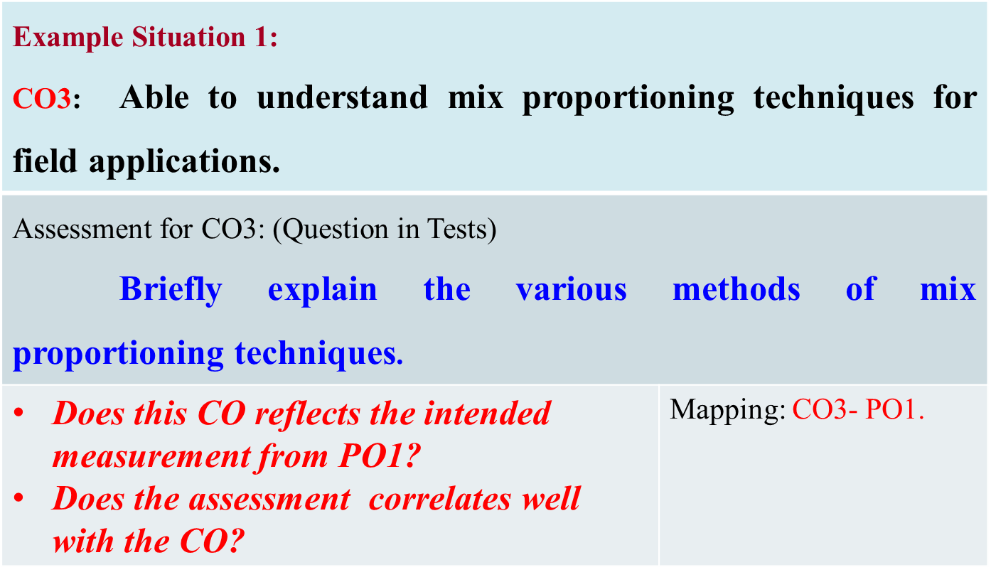
Is this mapping correct ?
Course Title: Concrete Technology
Course Outcomes | PO 1 | PO 2 | PO 3 | PO 4 | PO 5 | PO 6 | PO 7 | PO 8 | PO 9 | PO 10 | PO 11 | PO 12
Uunderstand mix proportioning techniques for field applications. | 3
Apply mix proportion principles to proportion a concrete mix for field applications. | 3
Design concrete mix for field applications using characteristics of mix constituents and relevant IS codes. |  | 2 | 3
Prepare a comprehensive report on new knowledge in any one of the topic related to concrete technology |  |  |  |  |  |  |  |  | 2 | 3 |  | 3
CO1

Slide 62
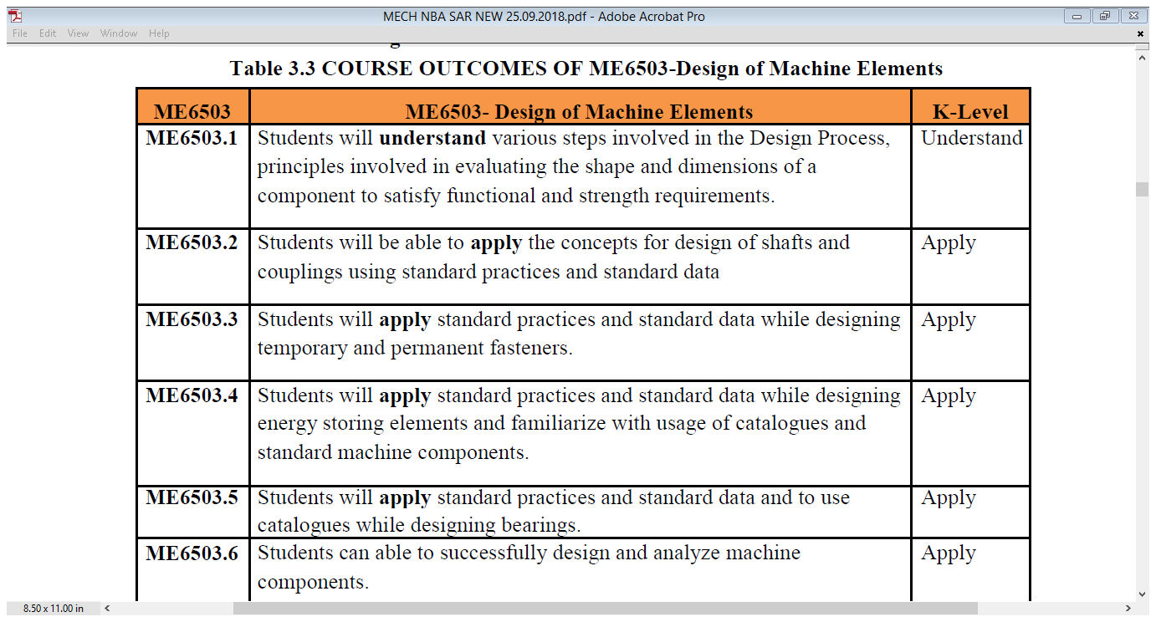
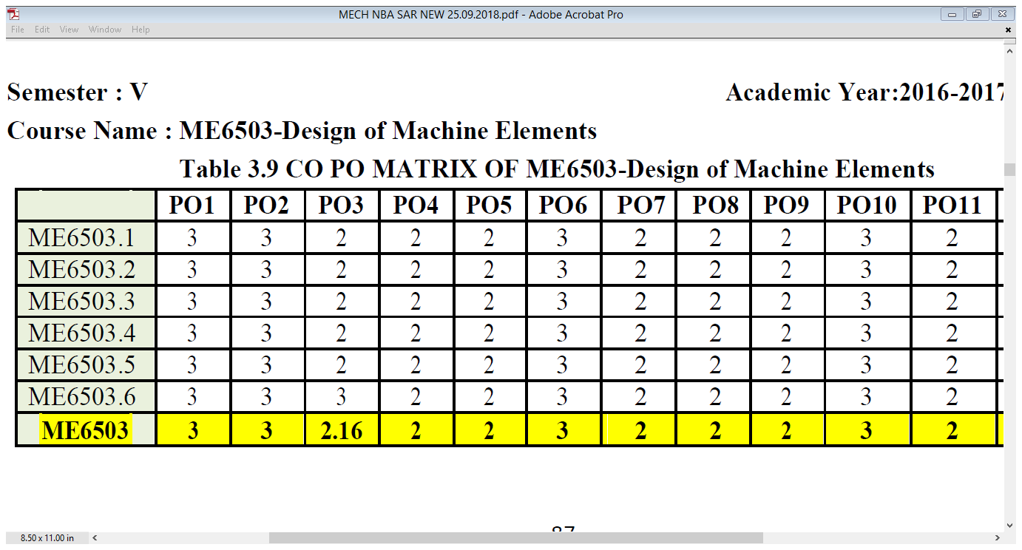
Communication

Slide 63
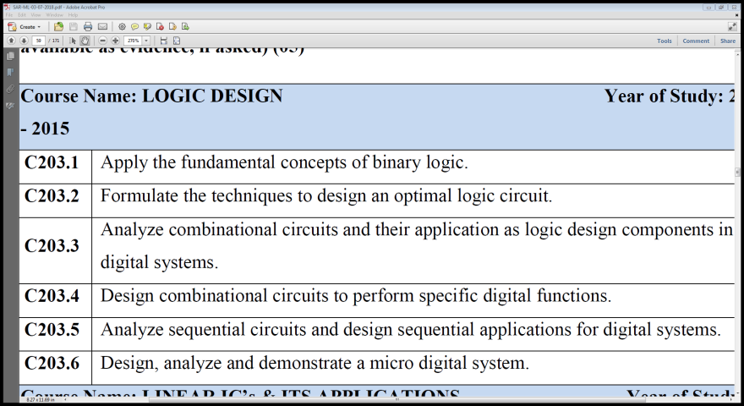
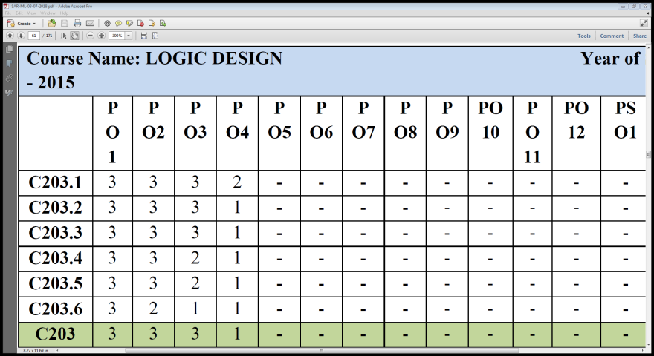
CO-PO mapping ??
Design
Apply

Slide 64
CO-PO Relationship
COURSE | COs | PO1 | PO2 | PO3 | PO4 | PO5 | PO6 | PO7 | PO8 | PO9 | PO10 | PO11 | PO12
Analysis of structures II | CO1 | 3 | 3 | - | - | - | - | - | - | - | - | - | -
 | CO2 | 3 | 3 | - | - | - | - | - | - | - | - | - | -
Environmental Engineering I | CO1 | 3 | 2 | - | 3 | - | 3 | 3 | - | - | - | - | -
 | CO2 | 3 | 3 | - | - | - | 3 | 3 | - | - | 3 | - | -
 | CO3 | - | - | 3 | - | - | - | 3 | 3 | - | 3 | - | -
Geotechnical Engineering II | CO1 | 3 | 3 | - | - | - | - | - | - | - | - | - | -
 | CO2 | 3 | 3 | - | - | - | - | - | - | - | - | - | -
 | CO3 | 3 | 3 | - | - | - | - | - | - | - | - | - | -
 | CO4 | 3 | 3 | 2 | - | - | 3 | - | - | - | - | - | -
Concrete Technology | CO1 | 3 | - | - | - | - | - | - | - | - | - | - | -
 | CO2 | - | 3 | 3 | - | - | - | - | - | - | - | - | -
 | CO3 | - | 3 | 3 | - | - | - | - | - | - | - | - | -
 | CO4 | - | - | - | - | - | - | - | 3 | 3 | - | - | -
Hydrology and water resources | CO1 | 3 | 3 | - | - | - | - | - | - | - | - | - | -
 | CO2 | 3 | 3 | - | - | - | - | - | - | - | - | - | -
 | CO3 | 3 | 3 | 3 | - | - | - | - | 3 | - | - | - | -
Quantity Surveying and Costing | CO1 | 3 | 3 | - | 1 | - | - | - | - | - | - | - | -
 | CO2 | 3 | 3 | - | - | 2 | 2 | - | - | - | - | - | -
 | CO3 | 3 | 3 | - | - | - | - | - | - | - | - | - | -
 | CO4 | 2 | 3 | 2 | - | - | 3 | - | - | - | - | - | -
Alternate Building Material & Technology | CO1 | 3 | - | - | - | - | - | 3 |  | - | - | - | 1
 | CO2 |  | 3 | - |  | - | - | 3 |  | - | - | - | 3
 | CO3 |  | - | - | - |  | - | 3 |  | - | - | - | 2
 | CO4 |  |  | 3 | - | 2 | - | 2 | 3 | - | - | - | -
Major Project Phase II | CO1 | - | - | - | - | - | - | 3 | - | 3 | - | - | -
 | CO2 | 3 | 3 | 3 | 3 | - | - | - | 3 | 3 | - | - | 3
 | CO3 | - | - | - | - | 3 | - | - | - | 3 | - | - | -
 | CO4 | - | - | - | - | - | - | - | - | 3 | 3 | 2 | -

Slide 65
Contd.
3.2. Attainment of Course Outcomes (50)
3.2.1. Describe the assessment processes used to gather the data upon which the evaluation of Course Outcome is based (10)
  Examples of data collection processes may include, but are not limited to-
    - Specific exam/tutorial questions
    - Assignments
    - Laboratory tests
    - Project evaluation
    - Student portfolios
  A portfolio is a collection of artifacts that demonstrate skills, personal characteristics, and accomplishments created by the student during study period, internally developed assessment exams, project presentations, oral exams etc.
Exhibits/Context to be Observed/Assessed:
A. & B. Evidence for appropriate assessment processes including data collection, verification, analysis, decision making
Notes:
-

Slide 66
Contd.
3.2.2. Record the attainment of Course Outcomes of all courses with respect to set attainment levels (40)
  Program shall have set Course Outcome attainment levels for all courses
  The attainment levels shall be set considering average performance levels in the University Examination or any higher value set as target for the assessment years
  Attainment level
    Student performance in internal assessments with respect the Course Outcomes
    Performance in the University Examination
Exhibits/Context to be Observed/Assessed:
A. Methodology to define set levels and its compliance; data collection, verification, analysis and decision making; details for one course per year of study to be verified
Notes:
-

Slide 67
Contd.
Measuring Course Outcomes attained through University Examinations
Example related to attainment levels Vs. targets:
(The examples indicated are for reference only. Program may appropriately define levels)
Attainment Level 1: 60% students scoring more than University average percentage marks or set attainment level in the final examination
Attainment Level 2: 70% students scoring more than University average percentage marks or set attainment level in the final examination
Attainment Level 3: 80% students scoring more than University average percentage marks or set attainment level in the final examination
Notes:
-

Slide 68
Contd.
Attainment is measured in terms of actual percentage of students getting set percentage of marks
If targets are achieved then all the course outcomes are attained for that year Program is expected to set higher targets for the following years as a part of continuous improvement
If targets are not achieved the program should put in place an action plan to attain the target in subsequent years
Measuring CO attainment through Internal Assessments:
Target may be stated in terms of percentage of students getting more than class average marks or set by the program in each of the associated COs in the assessment instruments (midterm tests, assignments, mini projects, reports and presentations etc. as mapped with the COs
Notes:
-

Slide 69
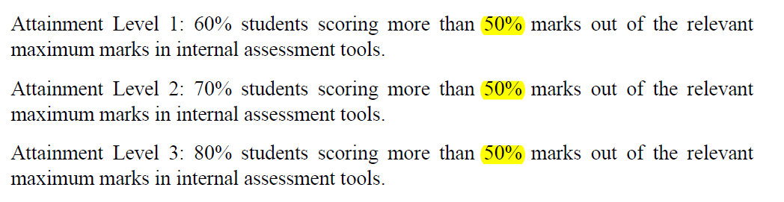
CO – Attainment
Target ??
Attainment Target ??
Tier 2

Slide 70
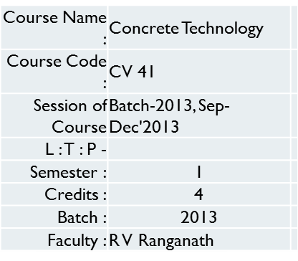
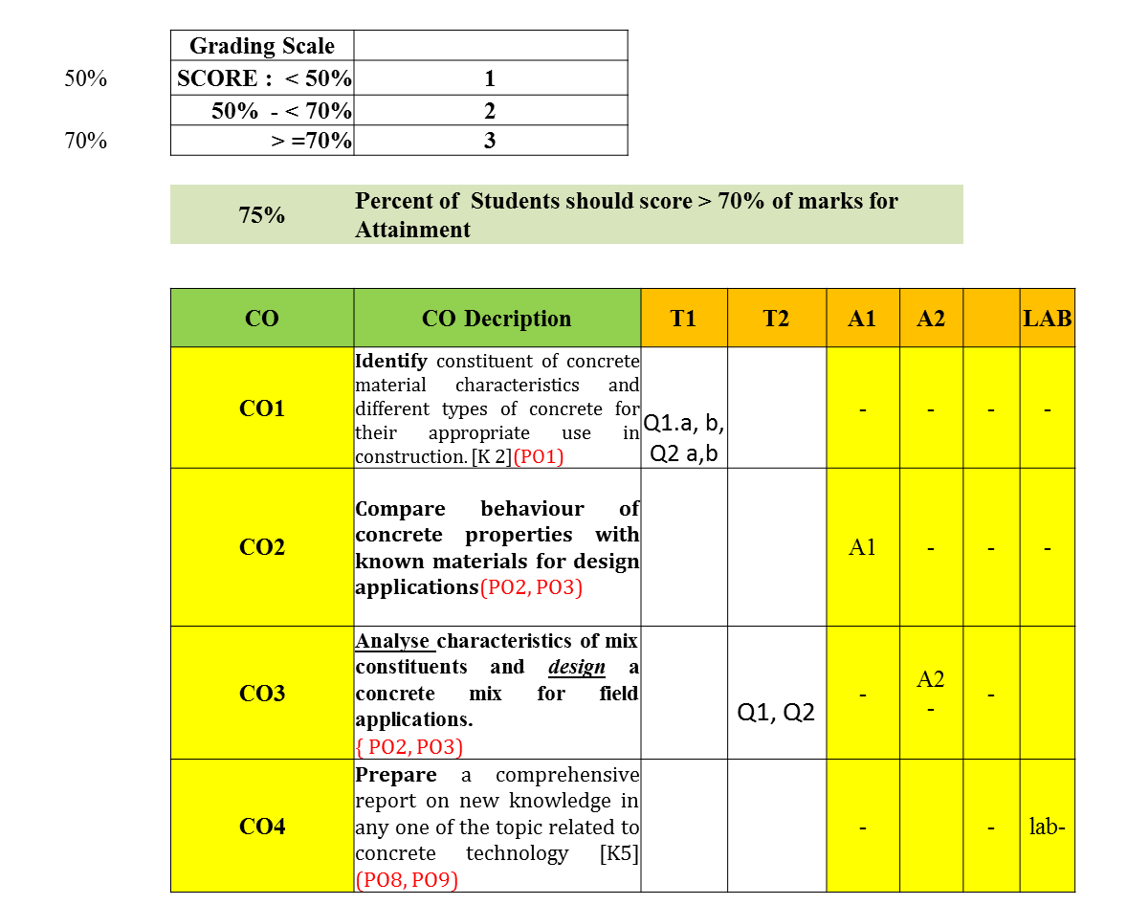
Example of CO-attainment for a course

Slide 71
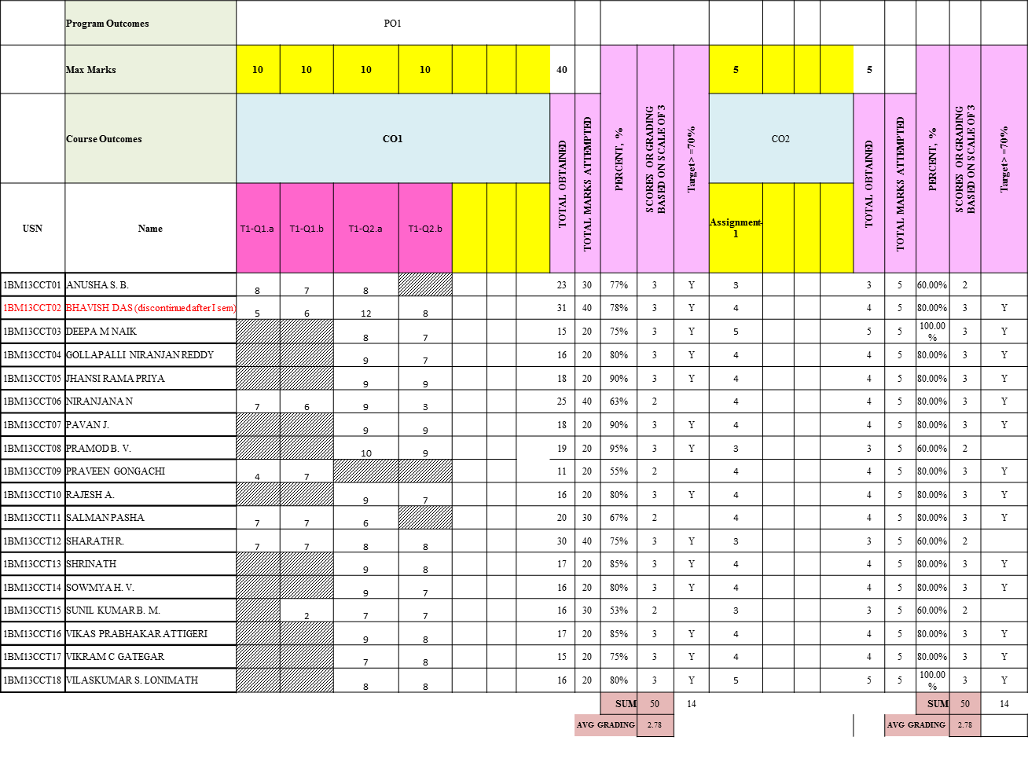
Example of CO-attainment for a course

Slide 72
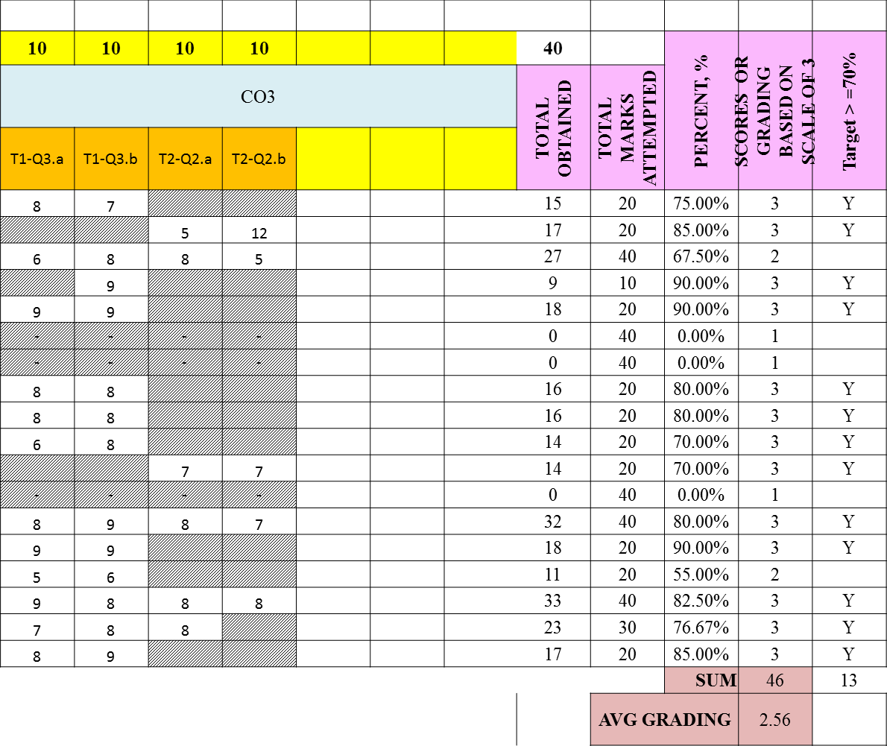
Example of CO-attainment for a course

Slide 73
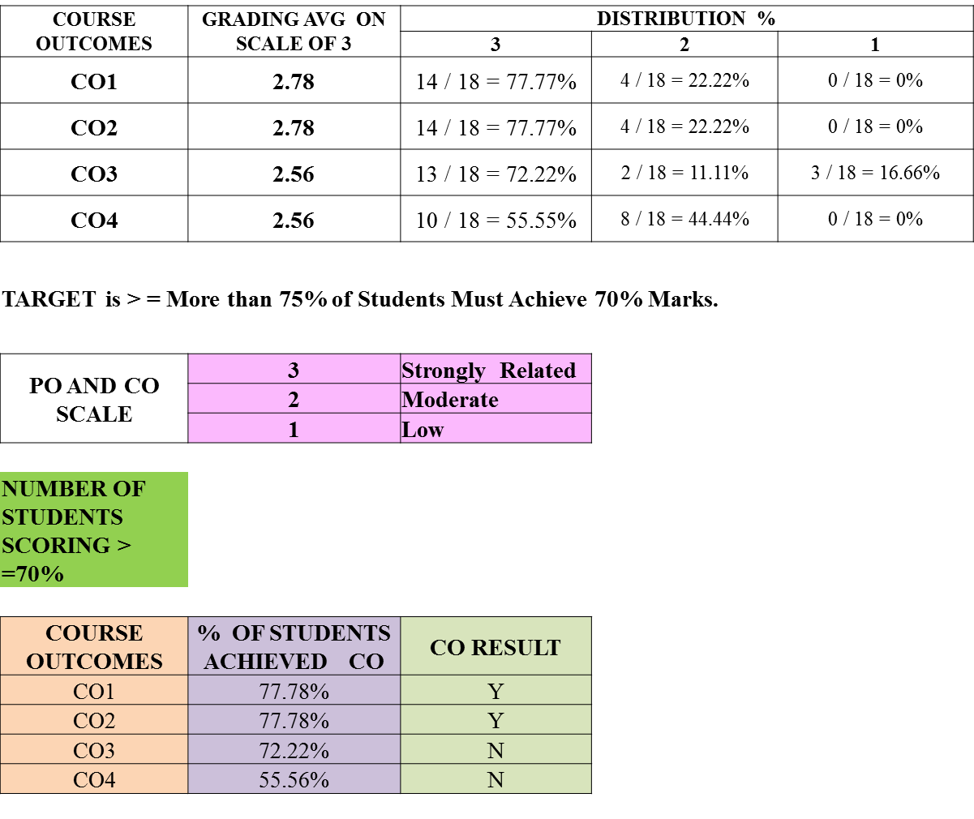
Example of CO-attainment for a course

Slide 74
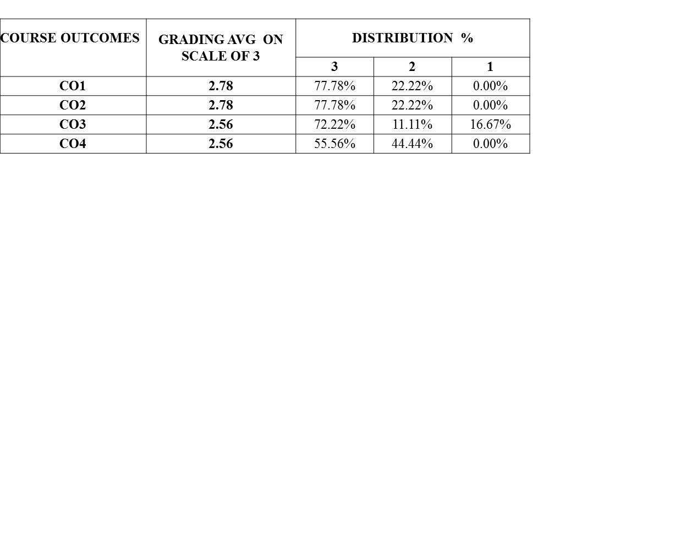
Example of CO-attainment for a course

Slide 75
CO Attainment
The assessments should be in alignment with the COs
Question paper should be so set to assess all COs
The average marks obtained in assessments against items for each CO will indicate the CO attainment.
Instructors can set targets for each CO of his/her course.
Attainment gaps can therefore be identified.
Instructor can plan to reduce the attainment gaps or enhance attainment targets.

Slide 76
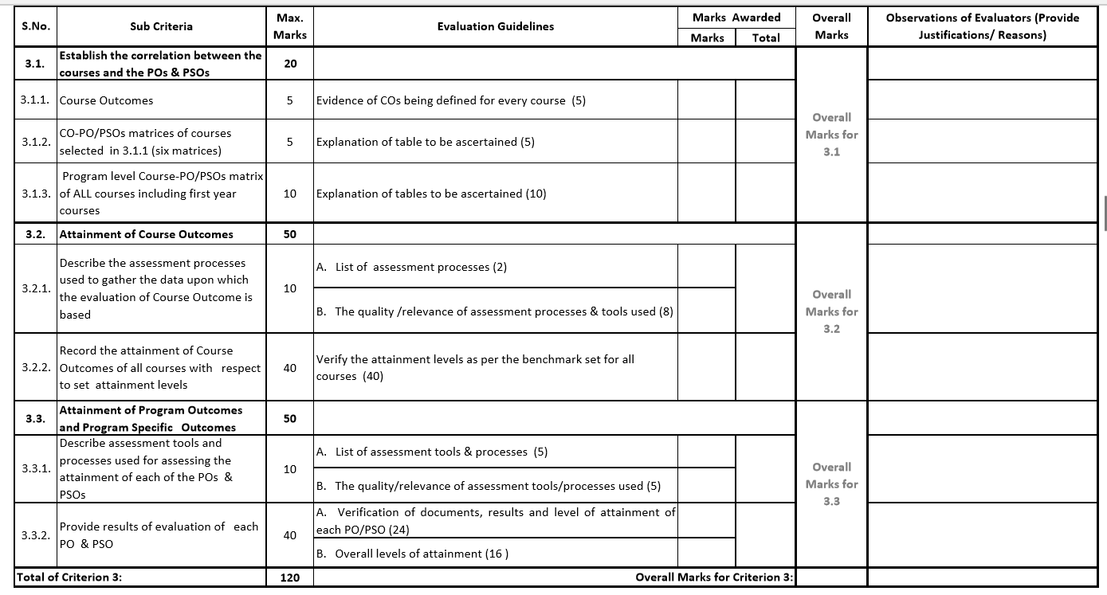

Slide 77
Contd.
3.3 Attainment of POs and PSOs (50)
3.3.1. Describe assessment tools and processes used for measuring the attainment of each of the Program Outcomes and Program Specific Outcomes (10)
  Describe the assessment tools and processes used to gather the data upon which the evaluation of each of the Program Outcomes and Program Specific Outcomes is based indicating the frequency with which these processes are carried out
  Describe the assessment processes that demonstrate the degree to which the Program Outcomes and Program Specific Outcomes are attained and document the attainment levels
Exhibits/Context to be Observed/Assessed:
A.&B. Direct and indirect assessment tools & processes ; effective compliance; direct assessment methodology, indirect assessment formats-collection analysis; decision making based on direct and indirect assessment
Notes:
-

Slide 78
Contd.
3.3.2. Provide results of evaluation of each PO & PSO (40)
Program shall set Program Outcome attainment levels for all POs and PSOs
The attainment levels by direct (student performance) and indirect (surveys) are to be presented through Program level Course-PO & PSO matrix as indicated
PO Attainment: Similar table is to be prepared for PSOs
Direct attainment level of a PO & PSO is determined by taking average across all courses addressing that PO and/or PSO.
Indirect attainment level of PO & PSO is determined based on the student exit surveys, employer surveys, co-curricular activities, extra-curricular activities etc.
Exhibits/Context to be Observed/Assessed:
A. & B. Appropriate attainment level and documentary evidences; details for POs & PSOs attainment from core courses to be verified. Also atleast two POs & two PSOs attainment levels shall be verified
Notes:
-

Slide 79
Contd.
Example:
It is assumed that a particular PO has been mapped to four courses C2O1, C3O2, C3O3 and C4O1
PO attainment level will be based on attainment levels of direct assessment and indirect assessment
For affiliated, non-autonomous colleges, it is assumed that while deciding on overall attainment level 80% weightage may be given to direct assessment and 20% weightage to indirect assessment through surveys from students(largely), employers (to some extent). Program may have different weightages with appropriate justification
Assuming following actual attainment levels
Notes:
-

Slide 80
Contd.
Direct Assessment
  C201 –High (3)
  C302 – Medium (2)
  C303 – Low (1)
  C401 – High (3)
Attainment level will be summation of levels divided by no. of courses
3+2+1+3/4= 9/4=2.25
Indirect Assessment
  Surveys, Analysis, customized to an average value as per levels 1, 2 & 3.
  Assumed level – 2
PO Attainment level will be 80% of Direct Assessment + 20% of Indirect Assessment i.e. 1.8 + 0.4 = 2.2, Moderate/Medium level of attainment
Note: Similarly for PSOs
Notes:
-

Slide 81
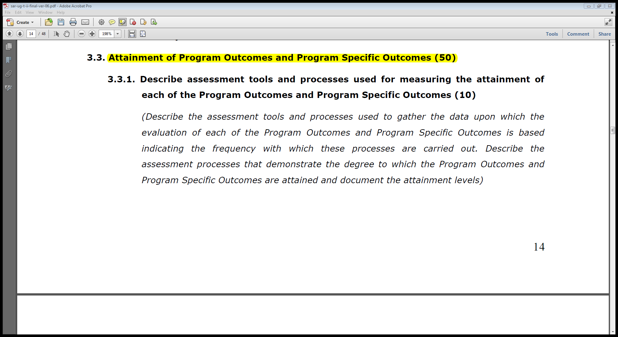
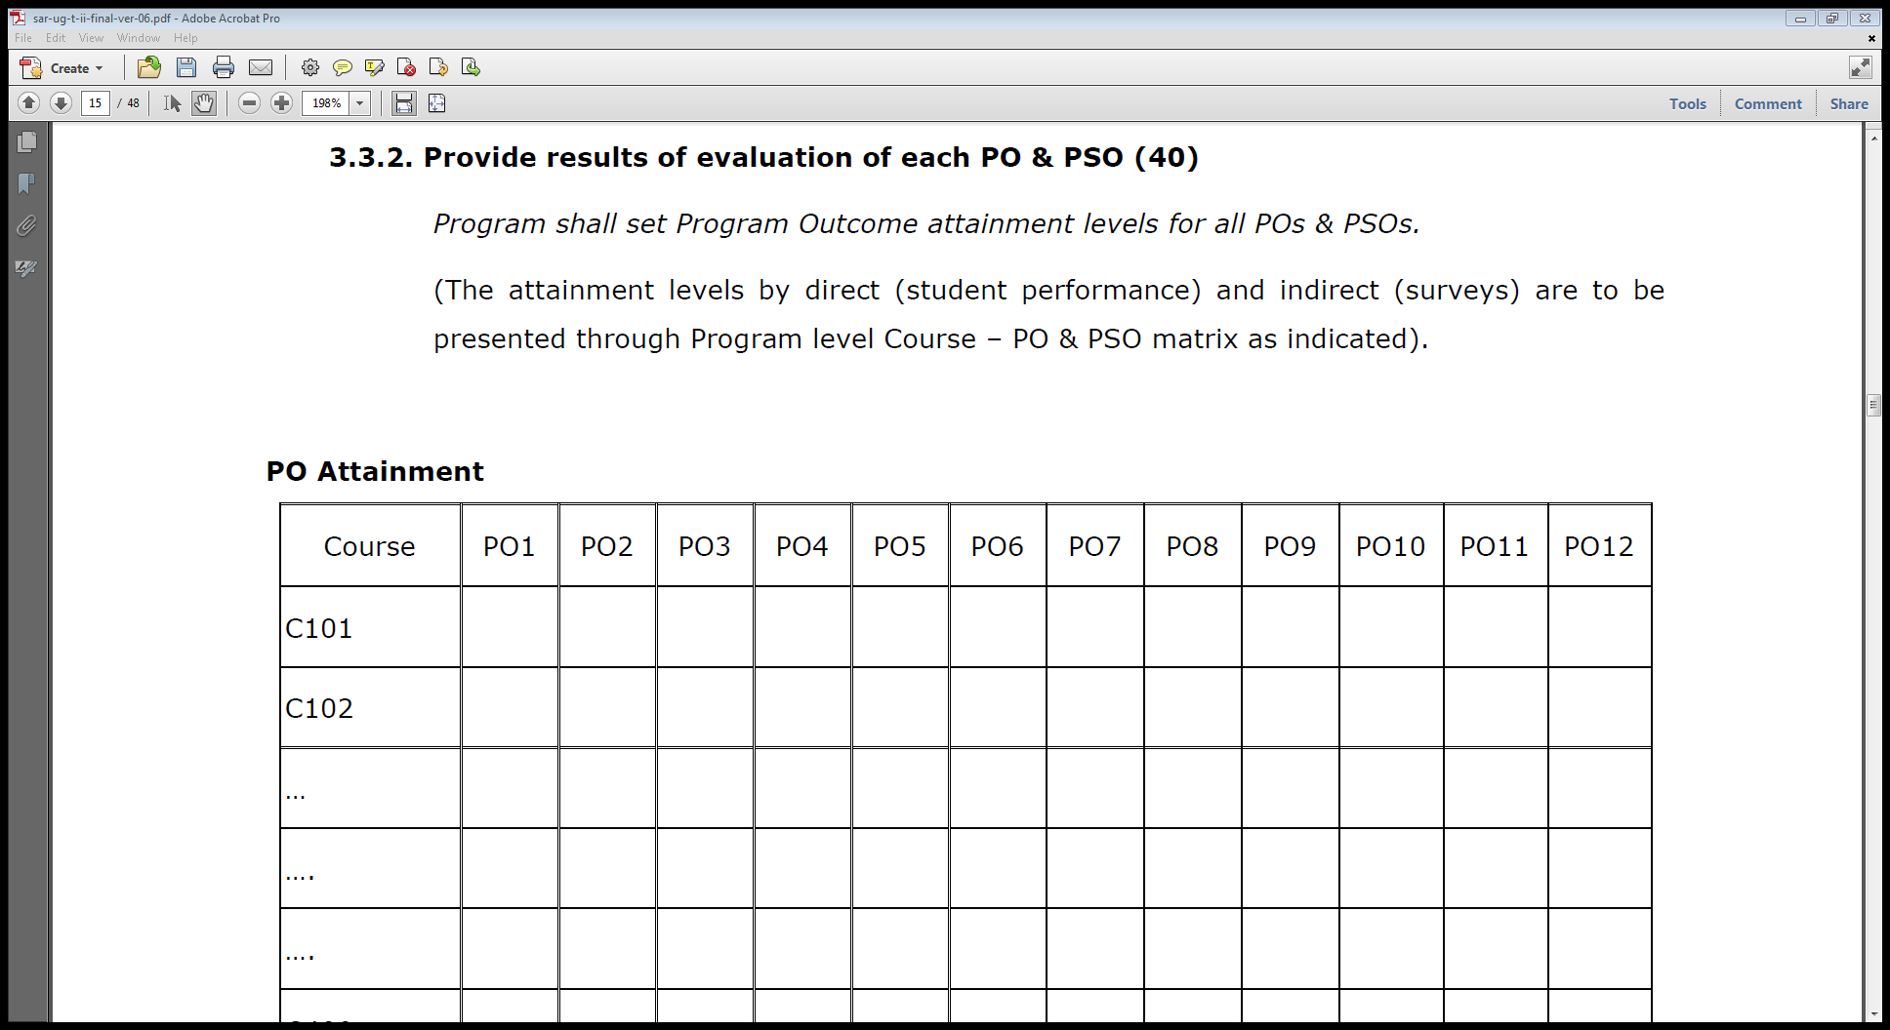
PO Attainment – Example..

Slide 82
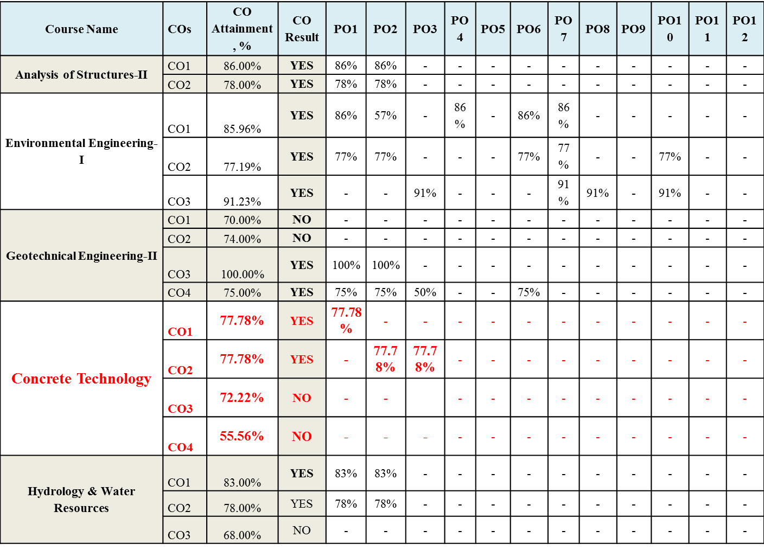
Attainment of Pos:

Slide 83
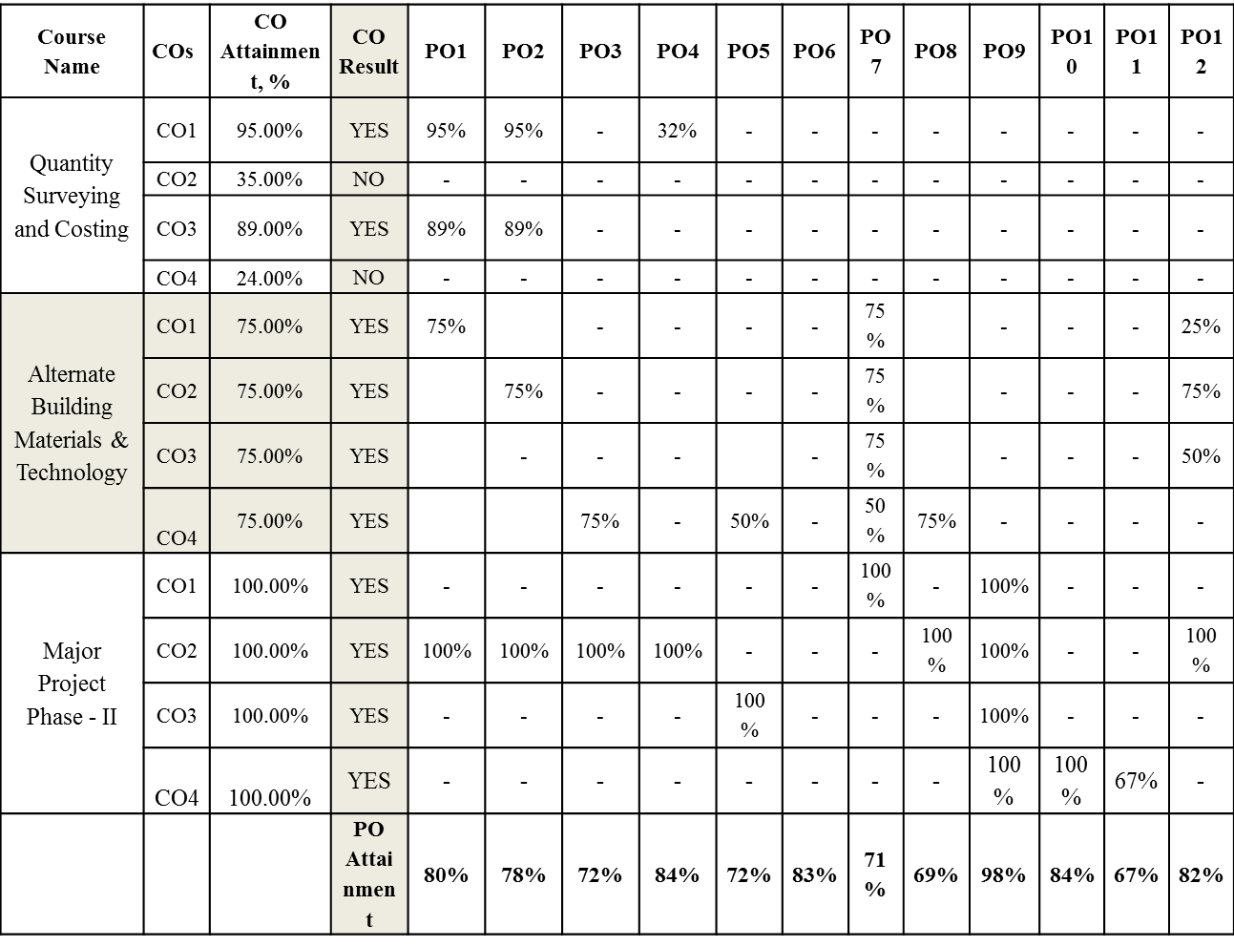
Contd…

Slide 84
Example Weightages for PO Attainment

Slide 85
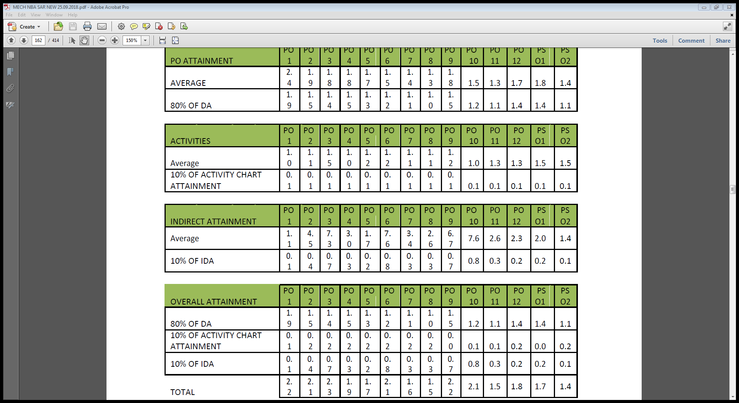
PO-Attainment: What next ?

Slide 86
PO Attainment
All POs can be adequately addressed through the selection of core courses and their COs
Attainable targets can be selected for each of the CO.
If assessment is in alignment with COs the performance of the students indicates the CO attainment.
These measurements provide the basis for continuous improvement in the quality of learning.

Slide 88
PO 1-5
POl. Engineering knowledge: Apply the knowledge of mathematics, science, engineering fundamentals, and engineering. specialization to the solution of complex engineering problems.
PO2. Problem analysis: Identify, formulate, review research literature, and analyze complex engineering problems reaching substantiated conclusions using first principles of mathematics, natural sciences, and engineering sciences.
PO 3 Design/development of solutions: Design solutions for complex engineering problems and design system components, processes to meet the specifications with consideration for the public health and safety, and the cultural, societal, and environmental considerations.
Conduct Investigations of Complex Problems: Use research-based knowledge and research methods including design of experiments, analysis and interpretation of data, and synthesis of the information to provide valid conclusions.
Modern Tool Usage: Create, select, and apply appropriate techniques, resources, and modern engineering and IT tools including prediction and modeling to complex engineering activities with an understanding of the limitations.

Slide 89
Complex Engineering Problem-CEP
1. Problems not the kind generally encountered at the ends of text book chapters. (These often test if the contents of the chapter have been understood)
2. These are problems that have not been
completely framed and leave at least a few* choices for the student to make.
3. Problems may require use of laws of physics, or bring in some mathematical tools in which the problem can be framed.

Slide 90
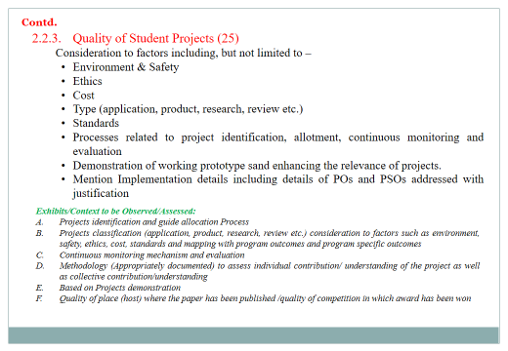
What are the ways for PEVs to verify evidence of solving complex engineering problems for PO attainment?
Can PBL help ?
What about Projects ?
  –Integrated Design Projects
    -Research Projects
    (Look for rubrics and the targeted POs.)

Slide 91



Problem-Based Learning

Slide 92

What’s the Difference?
Project-Based Learning
Individual or group
Teacher defines the problem
Teacher identifies action steps
Create a product
Both
Teacher as guide
Students at centre
Real-world connections
Active learning
Self and peer assessment
Problem-Based Learning
Groups
Students define the problem
Students identify action steps
Create a solution
Metacognition
Bottom Line:
In Problem-Based Learning, students have more control over their own learning and the processes involved.

Slide 93
Advantages of Problem Based Learning
Can be incorporated in any course
Learner-centred
Students acquire content knowledge, skills and attitudes
Facilitates measurement of skill based Programme Out comes namely, Team work, Communication, Life long learning…

Slide 94
Sample Problem

Slide 95
Problem Definition
BMS Construction Company has been in the forefront of concrete construction in India. It specializes in construction of Infrastructure and Buildings. The company wants to hire construction engineers who can take proactive role in the future projects of the company and build their career along with the company. Following are the requirements of the concrete engineer who will be responsible for the sourcing of materials, quality control of materials, proportioning of concrete mixes using locally available materials for different applications, evaluation of its properties (fresh, hardened and durability) pertaining to appropriate codes.

Slide 96
Expected Out Comes
The candidate should be well versed with the current trends of materials innovation, quality assurance practices, concrete production and testing methods and standards. Further, candidate is required to apply/demonstrate skills for communication, social concern and capacity to learn independently and reflect and implement new concreting requirement for the projects.

Slide 97
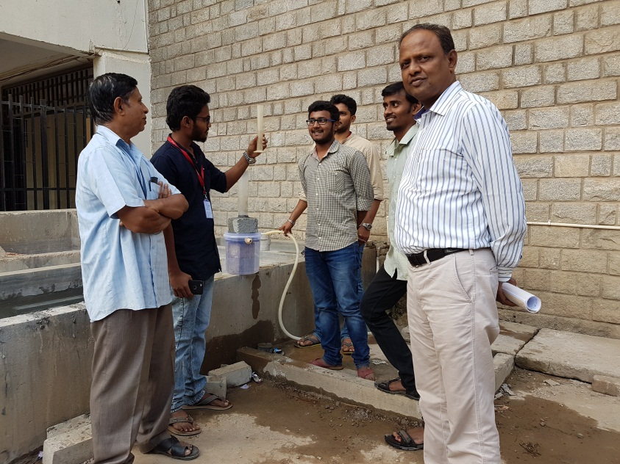

PBL - Example
Problem:
Development of Pervious concrete for pavements

Slide 98
Assessment strategy
Rubric for Evaluating Self Study
Course: 16CVCT1CCM- Advances in Construction Materials
Problem – Develop a concrete mix for field applications
Batch No: Title :
Performance Indicators ↓ | Unsatisfactory (2) | Developing (6) | Satisfactory (8) | Exemplary (10) | Score
Identifying Problem & Materials characteristics for possible solutions (PO1)
Choice of complexities of field requirement and identification of material characteristics (CO1-PO1) |  |  |  | Identified problem is complex and relevant to field application. All the characterization of material is carried out.
Research Analysis & Mix proportioning (PO2)
Identifying research gaps, setting objectives and Proportioning of mixes using standard methods (CO2-PO2)
Design of experiments (PO4)
Choice of Experiments to arrive at solutions. (CO3- PO4)
Communication and Life long learning (PO10, PO12)
Presentation and Reporting of work (CO4-PO10, PO12)
Total Score(Maximum, 40)

Slide 100
CRITERION 4: Students’ Performance
Item (Information-cumulatively for all the shifts with explicit headings) | CAY | CAYm1 | CAYm2
Sanctioned intake of the program (N)
Total number of students admitted in first year minus number of students migrated to other programs/institutions plus no. of students migrated to this program (N1)
Number of students admitted in 2nd year in the same batch via lateral entry (N2)
Separate division students, if applicable (N3)
Total number of students admitted in the Program (N1 + N2 + N3)
Notes:
-

Slide 101
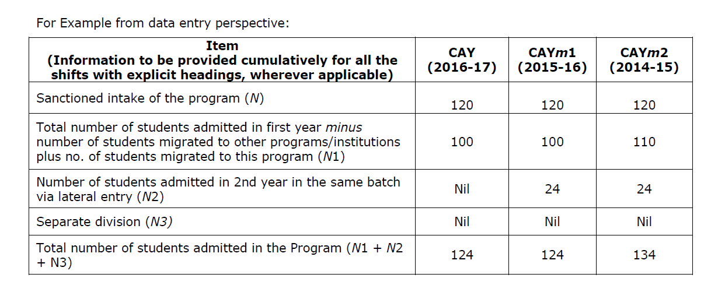
Data Entry
100

Slide 102
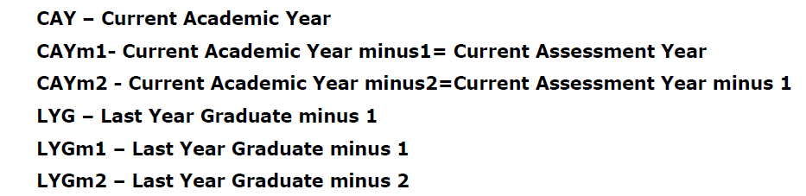
Contd.
Year of entry | N1 + N2 + N3 (As defined above) | Number of students who have successfully graduated without backlogs in any semester / year of study (Without Backlog means no compartment or failures in any semester/year of study)
 |  | I Year | II Year | III Year | IV Year
CAY
CAYm1
CAYm2
CAYm3 (LYG)
CAYm4 (LYGm1)
CAYm5 (LYGm2)
Notes:
-

Slide 103
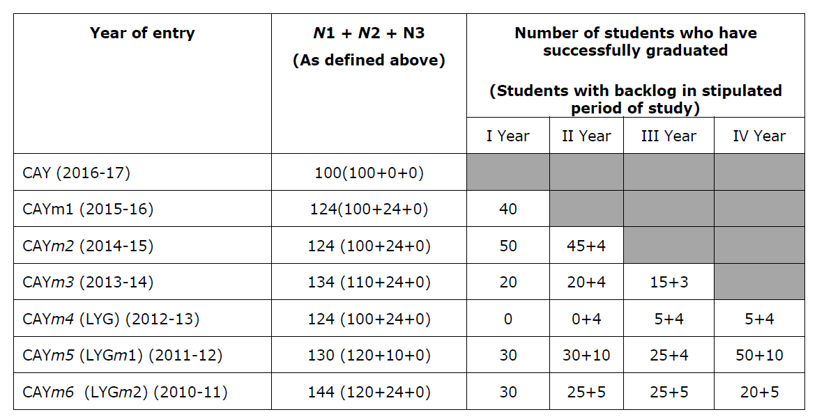

Slide 104
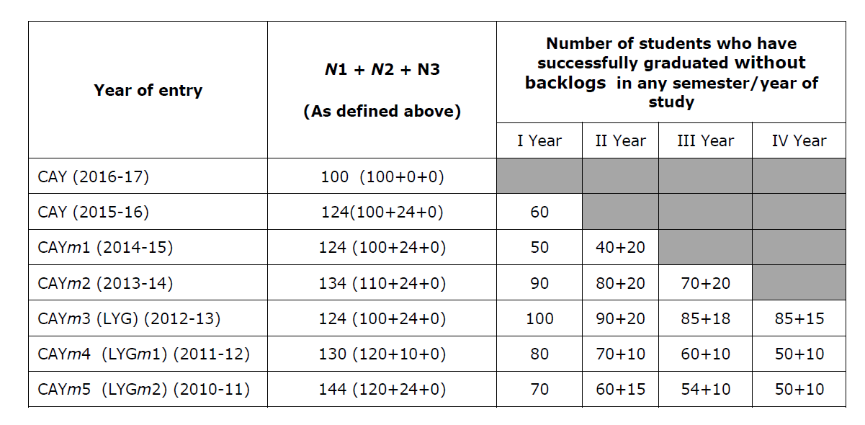


Slide 105
Contd.
4.1. Enrolment Ratio (20)
Enrolment Ratio= N1(Admitted)/N (Sanctioned)
Item (Students enrolled at the First Year Level on average basis during the period of assessment) | Marks
>= 90% students | 20
>= 80% students | 18
>= 70% students | 16
>= 60% students | 14
Otherwise | 0
Exhibits/Context to be Observed/Assessed:
A. B. & C. Data to be verified for each of the assessment years
Notes:
-

Slide 106
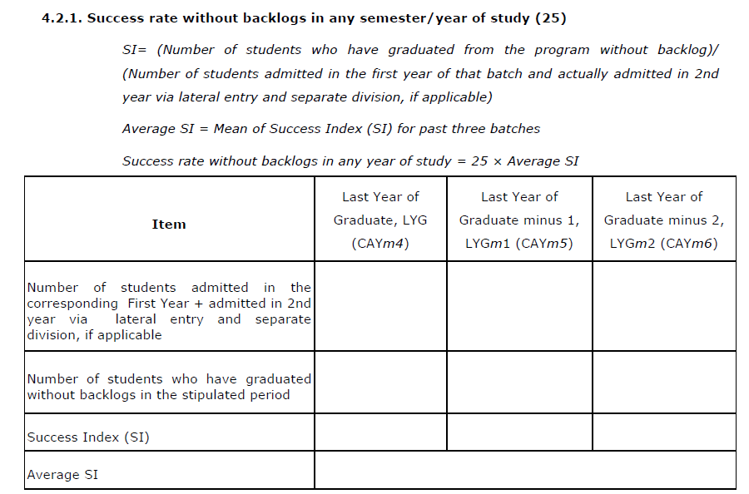
Contd.
Exhibits/Context to be Observed/Assessed:
Data to be verified for each of the assessment years
Notes:
-

Slide 107
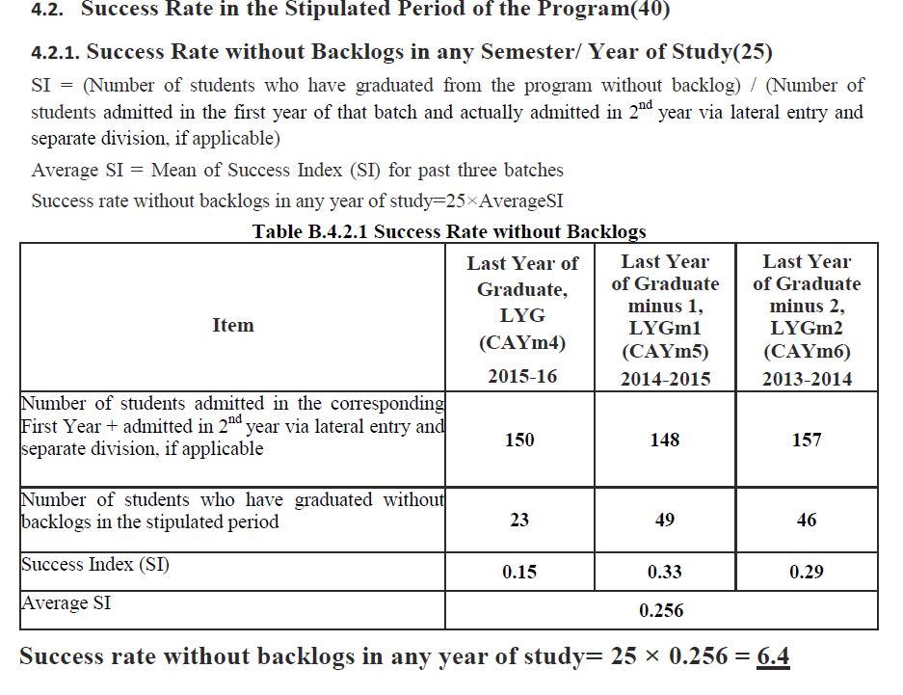

Slide 108
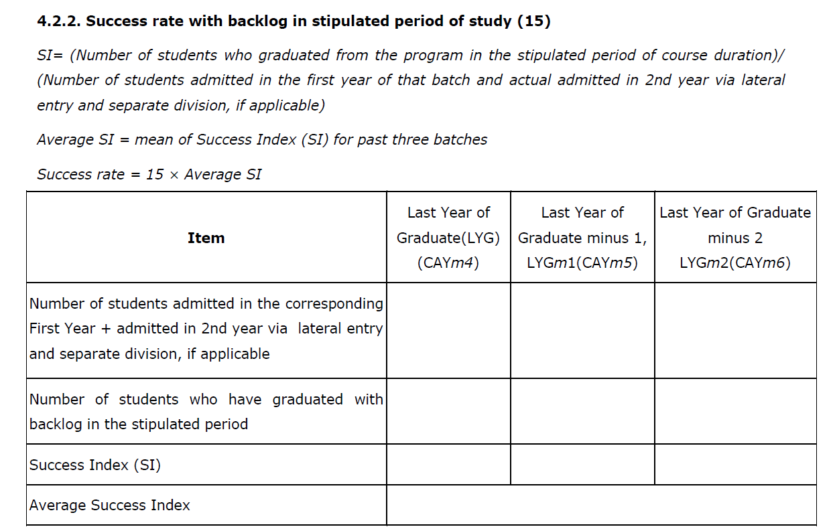
Contd.
Exhibits/Context to be Observed/Assessed:
Data to be verified for each of the assessment years
Note: If 100% students clear without any backlog then also total marks scored will be 40 as both 4.2.1 & 4.2.2 will be applicable simultaneously.
Notes:
-

Slide 109
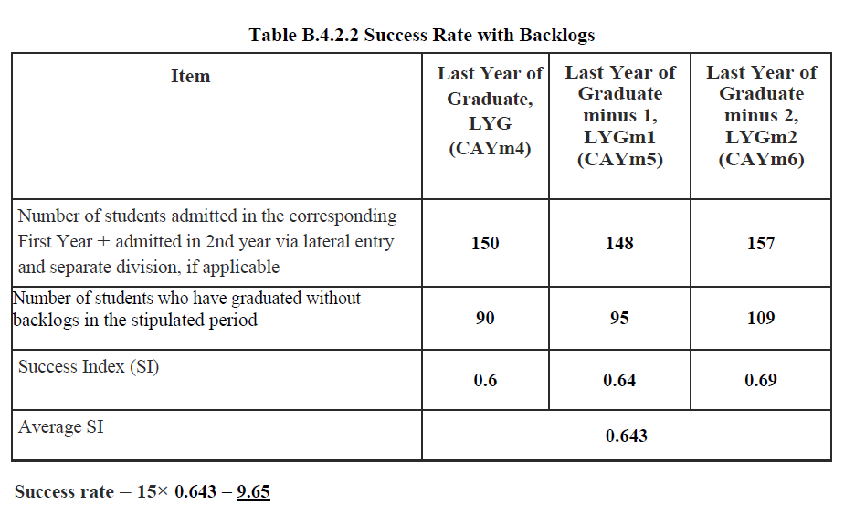

Slide 110
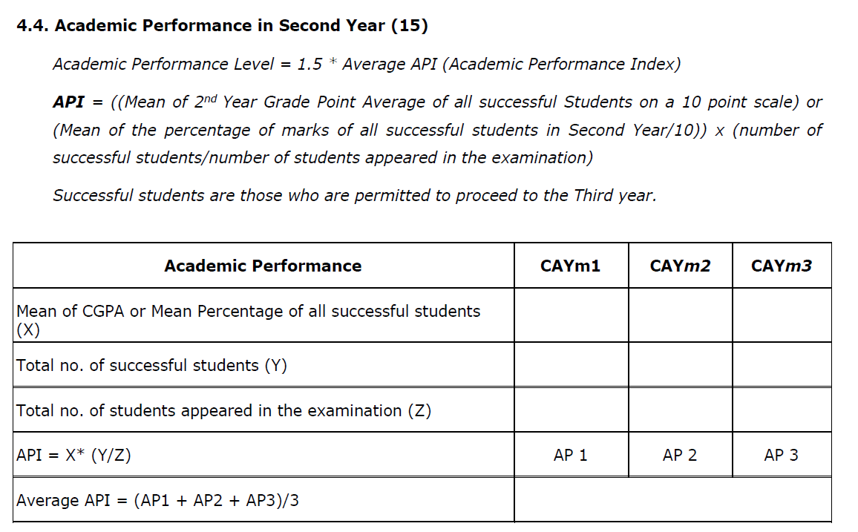
Contd.
Exhibits/Context to be Observed/Assessed:
Data to be verified for atleast one of the assessment years.
Notes:
-

Slide 111
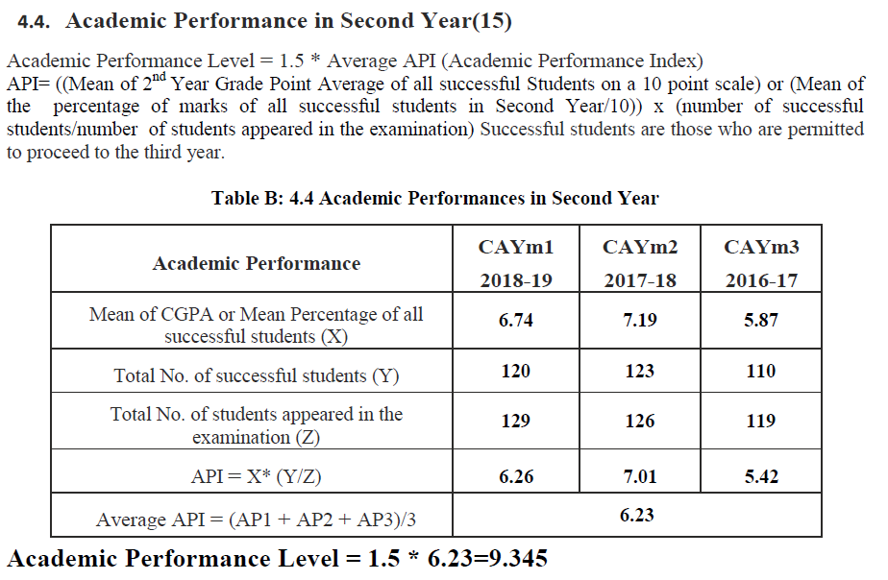

Slide 112
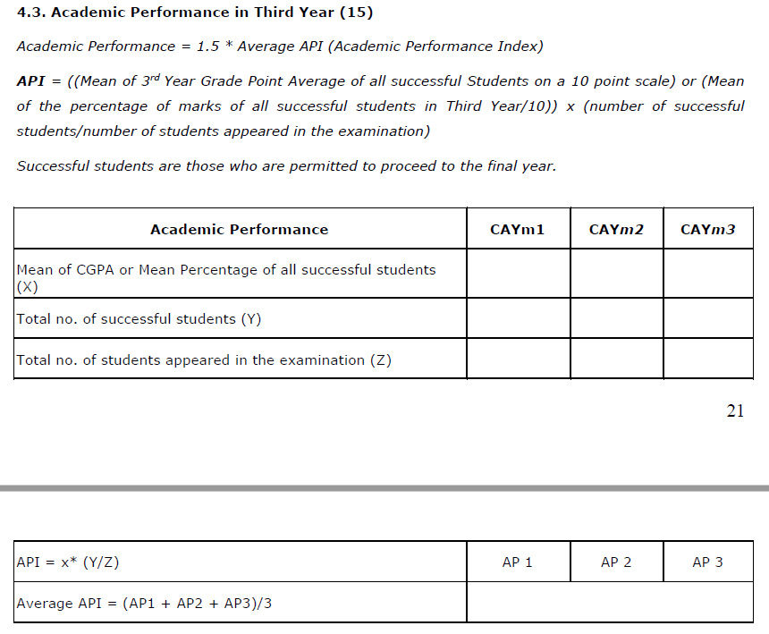
Contd.
Exhibits/Context to be Observed/Assessed:
Data to be verified for atleast one of the assessment years.
Notes:
-

Slide 113
Contd.
4.5. Placement, Higher Studies and Entrepreneurship
Assessment Points = 40 × average placement
Item | CAY | CAYm1 | CAYm2
Total No. of Final Year Students (N)
No. of students placed in companies or Government Sector (x)
No. of students admitted to higher studies with valid qualifying scores (GATE or equivalent State or National Level Tests, GRE, GMAT etc.) (y)
No. of students turned entrepreneur in engineering / technology (z)
x + y + z =
Placement Index : (x + y + z )/N | P1 | P2 | P3
Average placement= (P1 + P2 + P3)/3
Exhibits/Context to be Observed/Assessed:
Data to be verified for atleast one of the assessment years.
Notes:
-

Slide 114
Contd.
4.6. Professional Activities
4.6.1. Professional societies/chapters and organizing engineering events
  Relevant documentary evidences
    Professional Society/Chapters
    No. and Quality of Engineering events organized
    (Level - Institute/State/National/International)
Exhibits/Context to be Observed/Assessed:
Self -Explanatory.
4.6.2. Publication of technical magazines, newsletters, etc.
The Department publications along with the names of the editors, publishers, etc.
  Quality and relevance of the contents and print material
  Participation of students from the program
Notes:
-

Slide 115
Contd.
Exhibits/Context to be Observed/Assessed:
Documentary evidence
Documentary evidence - Students participation (also to be confirmed during interaction with the students)
4.6.3 Participation in inter-institute events by students of the program of study
Awards in the events/conferences organized by other institutes
  Within the State
  Outside the State
  Prized/Awards received
Exhibits/Context to be Observed/Assessed:
A.B.& C. Quality of events and documentary evidence
Notes:
-

Slide 116


Slide 117
CRITERION 5: Faculty Information and Contributions
Name of the Faculty Member | Qualification |  |  | Association with the Institution | Designation | Date on which Designated as Professor/ Associate Professor | Date of Joining the Institution | Department | Specialization | Academic Research |  |  | Currently Associated (Y/N) Date of Leaving (In case Currently Associated is (“No”) | Nature of Association (Regular/Contract)
 |  |  |  |  |  |  |  |  |  | Research Paper Publications | Ph.D. Guidance | Faculty Receiving Ph.D. during the Assessment Years
 | Degree (highest degree) | University | Year of attaining higher qualification
Notes:
-

Slide 118
Contd.
5.1. Student-Faculty Ratio (SFR)
(To be calculated at Department Level)
No. of UG Programs in the Department (n): __________
No. of PG Programs in the Department (m): __________
No. of Students in UG 2nd Year= u1
No. of Students in UG 3rd Year= u2
No. of Students in UG 4th Year= u3
No. of Students in PG 1st Year= p1
No. of Students in PG 2nd Year= p2
No. of Students = Sanctioned Intake + Actual admitted lateral entry students (The above data to be provided considering all the UG and PG programs of the department)
S=Number of Students in the Department = UG1 + UG2 +… +UGn + PG1 + …PGn
F = Total Number of Faculty Members in the Department (excluding first year faculty) Student Teacher Ratio (STR) = S / F
Notes:
-

Slide 119
Year | CAY | CAYm1 | CAYm2
u1.1
u1.2
u1.3
UG1 | u1.1+u1.2+u1.3 | u1.1+u1.2+u1.3 | u1.1+u1.2+u1.3
…
un.1
un.2
un.3
UGn | un.1+un.2+un.3 | un.1+un.2+un.3 | un.1+un.2+un.3
p1.1
p1.2
PG1 | p1.1+p1.2 | p1.1+p1.2 | p1.1+p1.2
…..
pm.1
pm.2
PGm | pn.1+pn.2 | pn.1+pn.2 | pn.1+pn.2
Total No. of Students in the Department (S) | UG1 + UG2 +.. +UGn + PG1 + …PGn | UG1 + UG2 + .. +UGn + PG1+… + PGn | UG1 + UG2 + .. +UGn + PG1+… + PGn
No. of Faculty in the Department (F) | F1 | F2 | F3
Student Faculty Ratio (SFR) | SFR1=S1/F1 | SFR2= S2/F2 | SFR3= S3/F3
Average SFR | SFR=(SFR1+SFR2+SFR3)/3

Slide 120


Slide 121
Marks to be given proportionally from a maximum of 20 to a minimum of 10 for average SFR between 20:1 to 25:1, and zero for average SFR higher than 25:1. Marks distribution is given as below:
< = 20 - 20 Marks
< = 25 - 10 Marks
> 25 - 0 Marks
Exhibits/Context to be Observed/Assessed:
SFR is to be verified considering the faculty of the entire department.
No. of Regular faculty calculation considering Regular faculty definition*; Faculty appointment letters, time table, subject allocation file, salary statements.
No. of students calculation as mentioned in the SAR(please refer table under criterion 5.1)
Faculty Qualification as per AICTE guidelines shall only be counted
* Note: Minimum 75% should be Regular/ full time faculty and the remaining shall be Contractual Faculty as per AICTE norms and standards.
The contractual faculty (doing away with the terminology of visiting/adjunct faculty, whatsoever) who have taught for 2 consecutive semesters in the corresponding academic year on full time basis shall be considered for the purpose of calculation in the Student Faculty Ratio.

Slide 122


Slide 123

Contd.
5.2. Faculty Cadre Proportion
The reference Faculty cadre proportion is 1(F1):2(F2):6(F3)
If AF1 = AF2= 0 then zero marks
Maximum marks to be limited if it exceeds 25
Example: Intake = 180; Required number of Faculty: total students as per 5.1/20 =702/20 = 35., ; RF1= 1/9 x35 =4, RF2=2/9x35=8 and RF3=6/9x35= 23.
Case 1: AF1/RF1= 1; AF2/RF2 = 1; AF3/RF3 = 1;
Cadre proportion marks = (1+0.6+0.4) x12.5 = 25
Case 2: AF1/RF1= 1; AF2/RF2 = 9/8; AF3/RF3 = 22/23;
Cadre proportion marks = (1+0.7+0.4) x12.5 = limited to 25
Case 3: AF1/RF1=0; AF2/RF2=1/2; AF3/RF3=11/9; To be observed carefully
Cadre proportion marks = (0+0.3+0.49) x12.5 = 9.87
Notes:
-

Slide 124

Contd.
5.2. Faculty Cadre Proportion
The reference Faculty cadre proportion is 1(F1):2(F2):6(F3)
Notes:
-

Slide 125
Exhibits/Context to be Observed/Assessed:
(Faculty Qualification and experience required for cadre posts shall only be considered as per AICTE norms/guidelines)
Cadre wise No. of faculty available; Faculty qualification and experience and eligibility; Appointment/Promotion orders
Cadre wise no. of faculty required as per AICTE guidelines (refer calculation in SAR)

Slide 126
Contd.
5.3. Faculty Qualification
FQ = 2.5 x [{10X +4Y}/F] where
X is no. of faculty with Ph.D.,
Y is no. of faculty with M.Tech,
F is no. of faculty required to comply 1:20 Faculty Student ratio
(no. of faculty and no. of students required to be calculated as per 5.1)
Exhibits/Context to be Observed/Assessed:
Documentary evidence – Faculty Qualification
Notes:
-

Slide 127
Contd.
5.4. Faculty Retention
No. of regular faculty members in CAYm2= CAYm1= CAY=
Item (During the period of assessment keeping CAYm3 as base year) | Marks
>=90% of required Faculty members retained | 25
>=75% of required Faculty members retained | 20
>=60% of required Faculty members retained | 15
>=50% of required Faculty members retained 10 | 10
<50% of required Faculty members retained | 0
Exhibits/Context to be Observed/Assessed:
Faculty date of joining; atleast three month (July-April-May) salary statement for each of the assessment years
Notes:
-

Slide 128
Contd.
5.5. Innovations by the Faculty in Teaching and Learning
Contributions to teaching and learning are activities that contribute to the improvement of student learning. These activities may include innovations not limited to-
  Use of ICT
  Instruction delivery
  Instructional methods
  Assessment
  Evaluation and inclusive class rooms that lead to effective, efficient and engaging instruction
Exhibits/Context to be Observed/Assessed:
Availability on Institute website; awareness among faculty and students of the department
& C. Self –explanatory
D. Innovations that contribute to the improvement of student learning, typically include use of ICT, instruction delivery, instructional methods, assessment, evaluation etc.
Notes:
-

Slide 129
Contd.
5.6. Faculty as participants in Faculty development / training activities/ STTPs
  A Faculty scores maximum five points for participation
  Participation in 2 to 5 days Faculty development program: 3 Points
  Participation >5 days Faculty development program: 5 points
Name of the Faculty | Max. 5 per Faculty
 | CAY | CAYm1 | CAYm2
Sum
RF= Number of Faculty required to comply with 20:1 Student-Faculty ratio as per 5.1
Assessment = 3 × (Sum/0.5RF) (Marks limited to 15)
Average assessment over three years (Marks limited to 15) =
Exhibits/Context to be Observed/Assessed:
Relevance of the training/development programme
No. of days; No. of faculty
Notes:
-

Slide 130
Contd.
5.7. Research and Development
5.7.1. Academic Research
Academic research includes research paper publications, Ph.D. guidance, and faculty receiving Ph.D. during the assessment period.
Number of quality publications in refereed/SCI Journals, citations, Books/Book Chapters etc.
Ph.D. guided /Ph.D. awarded during the assessment period while working in the institute
Exhibits/Context to be Observed/Assessed:
Quality of publications; publications copy
Documentary evidence
Notes:
-

Slide 131
Contd.
5.7.2. Sponsored Research
Funded research from outside
Provide a list with Project Title, Funding Agency, Amount and Duration
Funded research from outside; Cumulative during CAYm1, CAYm2 and CAYm3 Amount > 20 Lakh – 5 Marks
Amount >= 16 Lakh and <= 20 Lakh – 4 Marks
Amount >= 12 Lakh and < 16 Lakh – 3 Marks
Amount >= 8 Lakh and < 12 Lakh – 2 Marks
Amount >= 4 Lakh and < 8 Lakh – 1 Mark
Amount < 4 Lakh – 0 Mark
Exhibits/Context to be Observed/Assessed:
Documentary evidence; Funding agency, Amount, Duration, Research progress; Outcome
Notes:
-

Slide 132
Contd.
5.7.3. Development activities
Provide details:
  Product Development
  Research laboratories
  Instructional materials
  Working models/charts/monograms etc.
Exhibits/Context to be Observed/Assessed:
Self explanatory
5.7.4. Consultancy (from Industry)
Provide a list with Project Title, Funding Agency, Amount and Duration
Consultancy; (Cumulative during CAYm1, CAYm2 and CAYm3) Amount > 10 Lakh – 5 Marks
Amount >= 8 Lakh and <= 10 Lakh – 4 Marks Amount >= 6 Lakh and < 8 Lakh – 3 Marks Amount >= 4 Lakh and < 6 Lakh – 2 Marks Amount >= 2 Lakh and < 4 Lakh – 1 Mark Amount < 2 Lakh – 0 Mark
Notes:
-

Slide 133
Contd.
Exhibits/Context to be Observed/Assessed:
Documentary evidence; Funding agency, Amount, Duration, Research progress; Outcome
5.8. Faculty Performance Appraisal and Development System (FPADS)
The assessment is based on:
A well-defined system for faculty appraisal for all the assessment years
Its implementation, transparency and effectiveness
Exhibits/Context to be Observed/Assessed:
Notified performance appraisal and development system; Appraisal Parameters; Awareness
Implementation, Transparency and Effectiveness
Notes:
-

Slide 134
Contd.
5.9. Visiting/Adjunct/Emeritus Faculty etc.
Adjunct faculty also includes Industry experts. Provide details of participation and contributions in teaching and learning and /or research by visiting / adjunct / Emeritus faculty etc. for all the assessment years:
  Provision of inviting visiting/adjunct /Emeritus faculty
  Minimum 50 hours per year interaction with adjunct faculty from industry/retired professors etc.
Exhibits/Context to be Observed/Assessed:
Documentary evidence
Notes:
-

Slide 135

CRITERION 6: Facilities and Technical Support
6.1. Adequate and well equipped laboratories, and technical manpower
Adequate well-equipped laboratories to run all the program-specific curriculum (20)
Availability of adequate technical supporting staff (5)
Availability of qualified technical supporting staff (5)
Exhibits/Context to be Observed/Assessed:
Adequacy; well-equipped laboratories; utilization
& C. Self - explanatory
Notes:
-

Slide 136

Contd.
6.2. Additional facilities created for improving the quality of learning experience in laboratories
Availability and relevance of additional facilities(10)
Facilities utilization and effectiveness (10)
Relevance to POs and PSOs (5)
Exhibits/Context to be Observed/Assessed:
Self-explanatory
6.3. Laboratories: Maintenance and overall ambiance
Maintenance and overall ambience
Self-Explanatory
Notes:
-

Slide 137

Contd.
6.4. Project laboratory
Mention facility & Utilization
6.5. Safety measures in laboratories
Notes:
-

Slide 138
CRITERION 7: Continuous Improvement
7.1. Actions taken based on the results of evaluation of each of the POs & PSOs
  Identify the areas of weaknesses in the program based on the analysis of evaluation of POs & PSOs attainment levels
  Measures identified and implemented to improve POs & PSOs attainment levels for the assessment years
Examples of analysis and proposed action
Sample 1:
  Course outcomes for a laboratory course did not measure up, as some of the lab equipment did not have the capability to do the needful (e.g., single trace oscilloscopes available where dual trace would have been better, or, non availability of some important support software etc.)
  Action taken-Equipment up-gradation was carried out (with details of upgradation)
Notes:
-

Slide 139
Contd.
Sample 2:
In a course on EM theory student performance has been consistently low with respect to some COs
Analysis of answer scripts and discussions with the students revealed that this could be attributed to a weaker course on vector calculus
Action taken-revision of the course syllabus was carried out (instructor/text book changed too has been changed, when deemed appropriate)
Sample 3:
In a course that had group projects it was determined that the expectations from this course about PO3 (like: “to meet the specifications with consideration for the public health and safety, and the cultural, societal, and environmental considerations”) were not realized as there were no discussions about these aspects while planning and execution of the project
Action taken- Project planning, monitoring and evaluation included in rubrics related to these aspects
Notes:
-

Slide 140
Contd.
POs & PSOs Attainment Levels and Actions for improvement – CAY
 | Target Level | Attainment Level | Observations
PO1: Engineering knowledge: Apply the knowledge of mathematics, science, engineering fundamentals, and an engineering specialization to the solution of complex engineering problems.
Action 1: Action n:
PO2: Problem analysis: Identify, formulate, research literature, and analyze complex engineering problems reaching substantiated conclusions using first principles of mathematics, natural sciences, and engineering Sciences
Similar Tables should be presented for all POs & PSOs
Exhibits/Context to be Observed/Assessed:
Documentary evidence in respect of each of the POs
Notes:
-

Slide 141
Contd.
7.2. Academic Audit and actions taken thereof during the period of Assessment
  Assessment shall be based on conduct and actions taken in relation to Continuous Improvement
Exhibits/Context to be Observed/Assessed:
Academic Audit assessment criteria, frequency, conduct mechanism, action plan based on audit, implementation and effectiveness
7.3. Improvement in Placement, Higher Studies and Entrepreneurship Assessment is based on improvement in:
  Placement: number, quality placement, core industry, pay packages etc.
  Higher studies: performance in GATE, GRE, GMAT, CAT etc., and admissions in premier institutions
  Entrepreneurs
Exhibits/Context to be Observed/Assessed:
A. B. & C. Nos. in each year of the assessment; improvement considering CAYm3 as a base year
Notes:
-

Slide 142
Contd.
7.4. Improvement in the quality of students admitted to the program
Assessment is based on improvement in terms of ranks/score in qualifying-
  State level/National level entrances tests
  Percentage marks in Physics, Chemistry and Mathematics in 12th Standard
  Percentage marks of the lateral entry students
Exhibits/Context to be Observed/Assessed:
A. Documentary evidence – list of students admitted; admission authority guidelines; ranks/scores; comparative status considering CAYm3 as a base year
Notes:
-

Slide 143
CRITERION 8: First Year Academics
8.1. First Year Student-Faculty Ratio (FYSFR)
Assessment = (5 × 15)/Average FYSFR (Limited to Max. 5)
For each year of assessment = (5 × 20)/ FYSFR
(Limited to Max. 5) Average of Assessment of data in CAY, CAYm1 and CAYm2
*Note: If FYSFR is greater than 25, then assessment equal to zero.
Exhibits/Context to be Observed/Assessed:
No. of Regular faculty calculation considering Regular faculty definition and fractional load; Faculty appointment letters; Salary statements
No. of students calculation as mentioned in the SAR
Notes:
-

Slide 144
CRITERION 8: First Year Academics
8.2. Qualification of Faculty Teaching First Year Common Courses
  Assessment of qualification = (5x +3y)/RF
  x= Number of Regular Faculty with Ph.D
  y = Number of Regular Faculty with Post-graduate qualification
  RF= Number of faculty members required as per SFR of 20:1
Exhibits/Context to be Observed/Assessed:
Documentary evidence – Faculty Qualification
8.3. First Year Academic Performance
Academic Performance = ((Mean of 1st Year Grade Point Average of all successful Students on a 10 point scale) or (Mean of the percentage of marks in First Year of all successful students/10)) x (number of successful students/number of students appeared in the examination)
Successful students are those who are permitted to proceed to the Second year
Exhibits/Context to be Observed/Assessed:
Data to be verified for atleast one of the assessment years
Notes:
-

Slide 145
Contd.
8.4. Attainment of Course Outcomes of first year courses
8.4.1. Describe the assessment processes used to gather the data upon which the evaluation of Course Outcomes of first year is done
Examples of data collection processes may include, but are not limited to –
    Specific exam questions
    Laboratory tests
    Internally developed assessment exams
    Oral exams
    Assignments
    Presentations
    Tutorial sheets etc.
Exhibits/Context to be Observed/Assessed:
A. & B. Direct and indirect assessment(if applicable), tools & processes; effective compliance; direct assessment methodology, indirect assessment formats-collection-analysis; decision making
Notes:
-

Slide 146
Contd.
8.4.2. Record the attainment of Course Outcomes of all first year courses
Program shall have set attainment levels for all first year courses.
  The attainment levels shall be set considering average performance levels in the University Examination or any higher value set as target for the assessment years.
  Attainment level is to be measured in terms of student performance in internal assessments with respect the COs of a subject plus the performance in the University examination
A. Verify the records as per the benchmark set for the courses (5)
Exhibits/Context to be Observed/Assessed:
Documentary evidence – Attainment for atleast 3 courses
Notes:
-

Slide 147
Contd.
8.5. Attainment of Program Outcomes of all first year courses
8.5.1. Indicate results of evaluation of each relevant PO and/or PSO, if applicable
  The relevant program outcomes that are to be addressed at first year need to be identified by the institution
  Program Outcome attainment levels shall be set for all relevant POs and/or PSOs through first year courses
COURSE | COs | PO1 | PO2 | PO3 | PO4 | PO5 | PO6 | PO7 | PO8 | PO9 | PO10 | PO11
C101
C102
...
...
Direct Attainment
Exhibits/Context to be Observed/Assessed:
A. & B. Documentary evidence for each relevant PO/PSO
Notes:
-

Slide 148
Contd.
8.5.2. Actions taken based on the results of evaluation of relevant POs
The attainment levels by direct (student performance) are to be presented through Program level Course-PO matrix as indicated
PO Attainment Levels and Actions for improvement CAY
 | Target Level | Attainment Level | Observations
PO1: Engineering knowledge: Apply the knowledge of mathematics, science, engineering fundamentals, and an engineering specialization to the solution of complex engineering problems.
Action 1: Action n:
PO2: Problem analysis: Identify, formulate, research literature, and analyze complex engineering problems reaching substantiated conclusions using first principles of mathematics, natural sciences, and engineering Sciences
Note: PSOs, if applicable to be added appropriately
Exhibits/Context to be Observed/Assessed:
A. & B. Documentary evidence for each relevant PO/PSO
Notes:
-

Slide 149
CRITERION 9: Student Support Systems
9.1 Mentoring system to help at individual level
  Type of mentoring: Professional guidance / career advancement / course work specific / laboratory specific / all-round development
  Number of faculty mentors
  Number of students per mentor
  Frequency of meeting
Exhibits/Context to be Observed/Assessed:
A. Mentoring system terms of reference; implementation; effectiveness (also to be verified during interaction with the students)
Notes:
-

Slide 150
CRITERION 9: Student Support Systems
9.2. Feedback analysis and reward /corrective measures taken, if any
  Feedback collected for all courses: YES/NO
  Feedback questionnaire
  Specify the feedback collection process
  Average Percentage of students who participated
  Specify the feedback analysis process
  Basis of reward / corrective measures, if any: Indices used for measuring quality of teaching and learning
  Summary of the index values for all courses/teachers
  Number of corrective actions taken
Exhibits/Context to be Observed/Assessed:
A. Feedback questions, collection process, analysis, actions taken, effectiveness
Notes:
-

Slide 151
Contd.
9.3. Feedback on facilities
Assessment is based on -
  Feedback collection
  Analysis and corrective action taken
9.4. Self Learning
The institution needs to specify –
  Facilities
  Materials
  Scope for self-learning / learning beyond syllabus
  Webinars
  Podcast
  MOOCs
  Evaluate effectiveness
Notes:
-

Slide 152
Contd.
9.5. Career Guidance, Training, Placement
The institution may specify –
  Facility
  Management
  Effectiveness for career guidance including counseling for higher studies
  Campus placement support
  Industry interaction for training/internship/placement, etc.
Exhibits/Context to be Observed/Assessed:
Availability, implementation, effectiveness (also to be verified during interaction with the students)
9.6. Entrepreneurship Cell
The institution may specify –
  Facility
  Management
  Effectiveness in encouraging entrepreneurship and incubation
  Success stories for each of the assessment years
Exhibits/Context to be Observed/Assessed:
Availability, implementation, effectiveness (also to be verified during interaction with the students)
Notes:
-

Slide 153
Contd.
9.7. Co-curricular and Extra-curricular Activities
The institution may specify –
  Co-curricular and extra-curricular activities
Availability of sports and cultural facilities (3)
NCC, NSS and other clubs (3)
Annual students activities (4)
Exhibits/Context to be Observed/Assessed:
Availability, implementation, effectiveness (also to be verified during interaction with the students)
Notes:
-

Slide 154
CRITERION 10: Governance, Institutional Support and Financial Resources
10.1 Organization, Governance and Transparency
10.1.1. State the Vision and Mission of the Institute
Vision statement typically indicates aspirations and Mission statement states the broad approach to achieve aspirations
    Availability
    Appropriateness/relevance
Exhibits/Context to be Observed/Assessed:
Institute Vision and Mission statements: Availability of statements on Institute website; Availability at Central facilities such as Library, Computer Center, Principal Chamber etc. Availability of one set of statements in each of the departments; Availability in Institute level documents
Correctness from definition perspective
Notes:
-

Slide 155
CRITERION 10: Governance, Institutional Support and Financial Resources
10.1.2. Governing body, administrative setup, functions of various bodies, service rules, procedures, recruitment and promotional policies
List the governing, senate, and all other academic and administrative bodies; their memberships, functions, and responsibilities; frequency of the meetings; and attendance therein
The published rules including service rules, policies and procedures; year of publication shall be listed
Minutes of the meetings, Action taken reports, extent of awareness among the employees/students
Exhibits/Context to be Observed/Assessed:
Self explanatory
Notes:
-

Slide 156
Contd.
10.1.3. Decentralization in working and grievance redressal mechanism
  List the names of the faculty members who have been delegated powers for taking administrative decisions
  Grievance Redressal cell
  Action taken report for the above point
Exhibits/Context to be Observed/Assessed:
A. B. & C. Documentary evidence
10.1.4. Delegation of financial powers
  Institution should explicitly mention financial powers delegated to the Principal, Heads of Departments and relevant in-charges
  Demonstrate the utilization of financial powers for each year of the assessment years
Exhibits/Context to be Observed/Assessed:
Circulars notifying financial powers
Documentary evidence to exhibit utilization at each levels during assessment years
Notes:
-

Slide 157
Contd.
10.1.5. Transparency and availability of correct/unambiguous information in
public domain
  Information on policies, rules, processes and dissemination of this information to stakeholders is to be made available on the web site
  Disseminating of information about student, faculty and staff
Exhibits/Context to be Observed/Assessed:
A. & B. Website and Documentary evidence
Notes:
-

Slide 158
Contd.
10.2. Budget Allocation, Utilization, and Public Accounting at Institute level
Summary of current financial year’s budget and actual expenditure incurred (for the institution exclusively) in the three previous financial years.
Total Income at Institute level: For CFY, CFYm1, CFYm2 & CFYm3
For CFY: Similar tables are to be prepared for CFYm1, CFYm2 & CFYm3
Total Income |  |  |  | Actual expenditure (till …) |  |  | Total No. of students:
Fee | Govt. | Grant(s) | Other Sources (specify) | Recurring including Salaries | Non recurring | Special Projects/Any other, specify | Expenditure per student
Notes:
-

Slide 159
Contd.
Items | Budgeted in CFY | Actual expenses in CFY (till …) | Budgeted in CFYm1 | Actual Expenses in CFYm1 | Budgeted in CFYm2 | Actual Expenses in CFYm2 | Budgeted in CFYm3 | Actual Expenses in CFYm3
Infrastructure Built-Up
Library
Laboratory equipment
Teaching and non-teaching staff salary
R&D
Laboratory consumables
Maintenance and spares
Training and Travel
Miscellaneous expenses
Others Specify
Total
Notes:
-

Slide 160
Contd.
10.2.1 Adequacy of budget allocation
  The institution needs to justify that the budget allocated over the years was adequate
  Quantum of budget allocation for three years (5)
  Justification of budget allocated for three years (5)
Exhibits/Context to be Observed/Assessed:
Budget formulation, finalization and approval process
Requirement – allocation –adequacy – justification thereof
10.2.2 Utilization of allocated funds
  The institution needs to state how the budget was utilized during assessment years
Exhibits/Context to be Observed/Assessed:
A. Balance sheet; effective utilization; random verification for atleast two of the three assessment years
Notes:
-

Slide 161
Contd.
10.2.3 Availability of the audited statements on the institute’s website
  The institution needs to make audited statements available on its website.
Exhibits/Context to be Observed/Assessed:
Website
10.3 Program Specific Budget Allocation, Utilization
  Total Budget at program level: For CFY, CFYm1, CFYm2 & CFYm3
10.3.1. Adequacy of budget allocation
  Program needs to justify that the budget allocated over the assessment years was adequate for the program
Exhibits/Context to be Observed/Assessed:
Budget formulation, finalization and approval process
Requirement – allocation –adequacy – justification thereof
Notes:
-

Slide 162
Contd.
10.3.2. Utilization of allocated funds
  Program needs to state how the budget was utilized during the last three assessment years
Exhibits/Context to be Observed/Assessed:
A. Balance sheet; effective utilization; random verification for atleast two of the three assessment years
10.4. Library and Internet
    AICTE zero deficiency report for all the assessment years
    Effective availability
    Purchase records
    Utilization of facilities
    Documentation
Notes:
-

Slide 163
Contd.
10.4.1. Quality of learning resources (hard/soft)
  Relevance of available learning resources including e-resources
  Accessibility to students
Exhibits/Context to be Observed/Assessed:
Availability; Adequacy; Effectiveness
(Also to be verified during interactions with the faculty and students)
10.4.2. Internet
  Name of the Internet provider
  Available bandwidth
  Wi Fi availability
  Internet access in labs, classrooms, library and offices of all Departments
  Security arrangements
Exhibits/Context to be Observed/Assessed:
Availability as per AICTE norms; Adequacy; Effectiveness
(Also to be verified during interactions with the faculty and students)
Notes:
-

Slide 164





Slide 165


Slide 166
SAR Context
Provides preparedness status at I/P level for the NBA visit,
Provides the first impression about the I/P to the evaluation team,
Presents crisp program status to the evaluation team and addresses process and the extent to which, a program meets each criterion,
Provides documented evidences, which the evaluation team maps/matches with the visual /oral evidences during the visit.

Slide 167
THANK YOU

